Slide 1


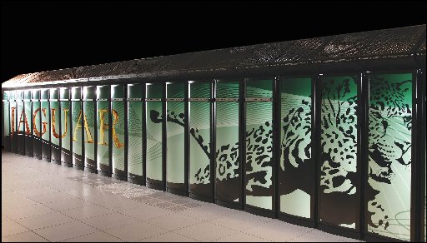
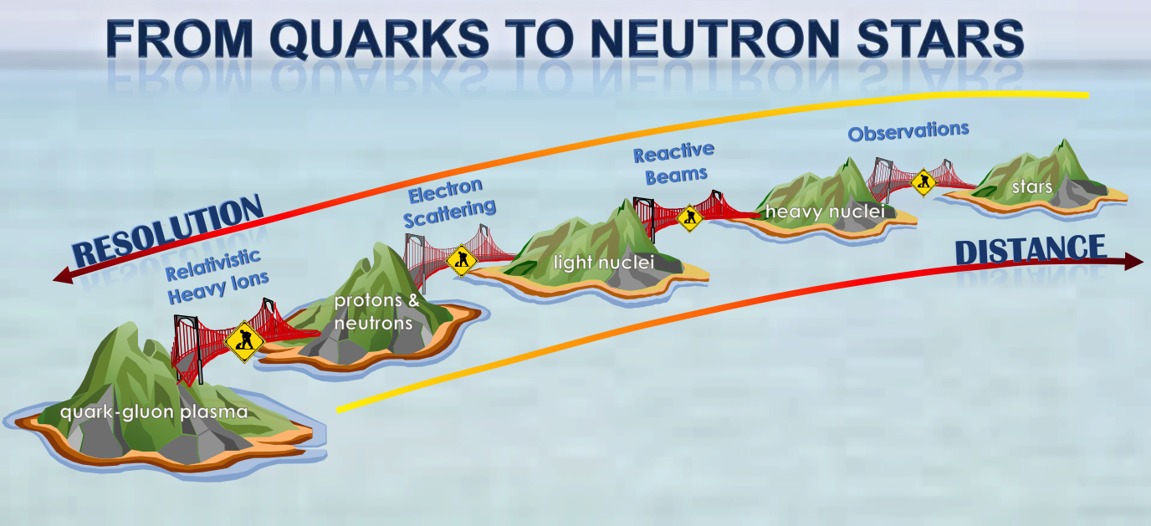
Nuclear structure III (theory)
Witek Nazarewicz (UTK/ORNL)
National Nuclear Physics Summer School 2014
William & Mary, VA
Nuclear Force
General principles
Examples: quantitative
nuclear theory; predictive capability
Realities of high-performance computing

Slide 2

The Force

Slide 3
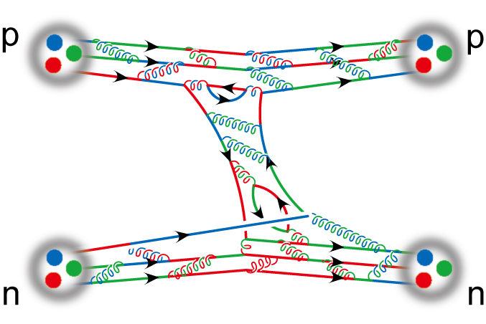
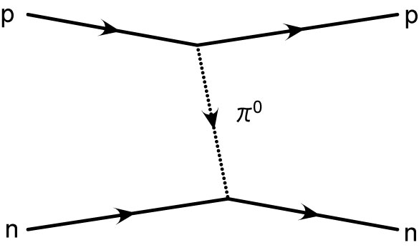
Nuclear force
A realistic nuclear force force: schematic view
Nucleon r.m.s. radius ~0.86 fm
Comparable with interaction range
Half-density overlap at max. attarction
V_{NN} not fundamental (more like inter-molecular van der Waals interaction)
Since nucleons are composite objects, three-and higher-body forces are expected.

Slide 4
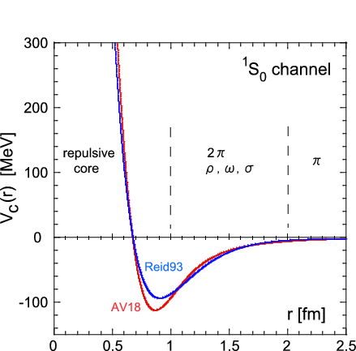
Nucleon-Nucleon interaction (qualitative analysis)
QCD!
There are infinitely many equivalent nuclear potentials!
Repusive core
OPEP
attraction
Reid93 is from
V.G.J.Stoks et al., PRC49, 2950 (1994).
AV16 is from
R.B.Wiringa et al., PRC51, 38 (1995).
quark-gluon structures
overlap
heavy mesons

Slide 5
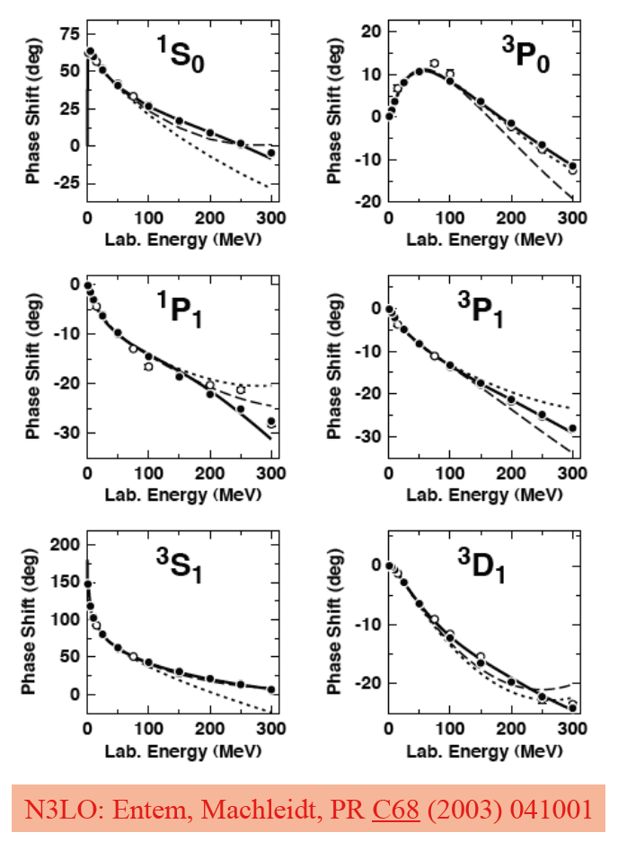
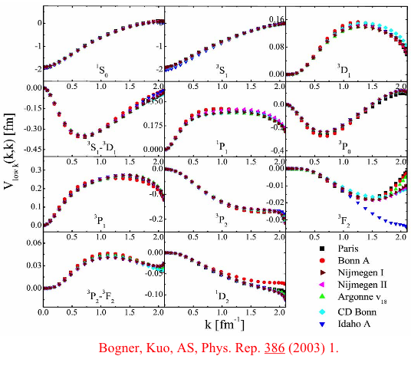
nucleon-nucleon interactions
Effective-field theory potentials
Renormalization group (RG) evolved nuclear potentials
V_{low-k} unifies NN interactions at low energy
N³LO: Entem et al., PRC68, 041001 (2003)
Epelbaum, Meissner, et al.
Bogner, Kuo, Schwenk, Phys. Rep. 386, 1 (2003)

Slide 6
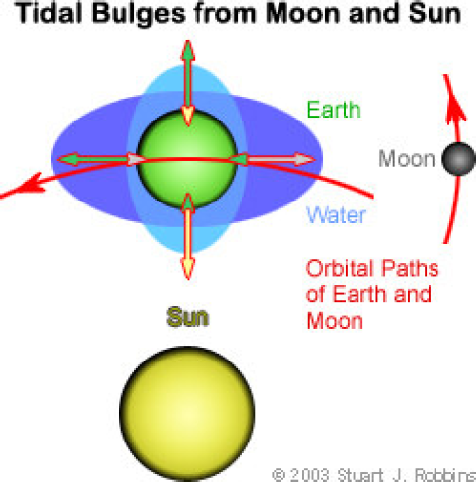
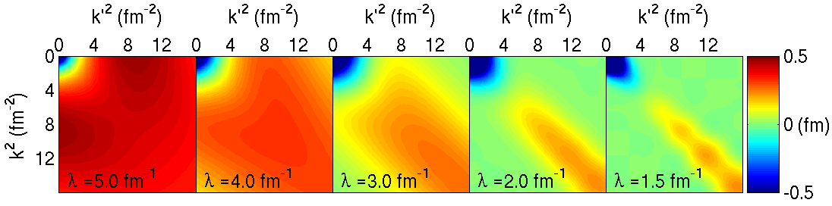
three-nucleon interactions
Three-body forces between protons and neutrons are analogous to tidal forces: the gravitational force on the Earth is not just the sum of Earth-Moon and Earth-Sun forces (if one employs point masses for Earth, Moon, Sun)
The computational cost of nuclear 3-body forces can be greatly reduced by decoupling low-energy parts from high-energy parts, which can then be discarded.
Recently the first consistent Similarity Renormalization Group softening of three-body forces was achieved, with rapid convergence in helium. With this faster convergence, calculations of larger nuclei are possible!
Notes:
6

Slide 7
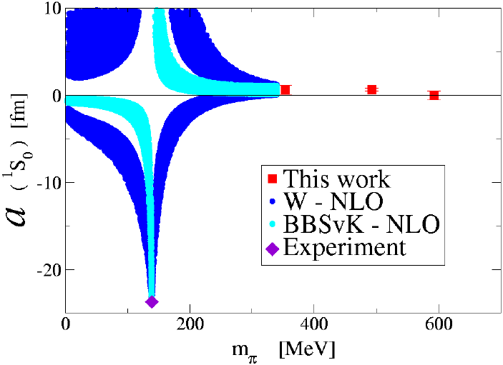

The challenge and the prospect: NN force
Ishii et al. PRL 99, 022001 (2007)
Beane et al. PRL 97, 012001 (2006)
and Phys. Rev. C 88, 024003 (2013)

Slide 8
Optimizing the nuclear force
input matters: garbage in, garbage out
The derivative-free minimizer POUNDERS was used to systematically optimize NNLO chiral potentials
The optimization of the new interaction NNLO_{opt} yields a χ²/datum ≈ 1 for laboratory NN scattering energies below 125 MeV. The new interaction yields very good agreement with binding energies and radii for A=3,4 nuclei and oxygen isotopes
Ongoing: Optimization of NN + 3NF
Used a coarse-grained representation of the short-distance interactions with 30 parameters
The optimization of a chiral interaction in NNLO yields a χ²/datum ≈ 1 for a mutually consistent set of 6713 NN scattering data
Covariance matrix yields correlation between LECCs and predictions with error bars.
Navarro Perez, Amaro, Arriola,
Phys. Rev. C 89, 024004 (2014) and
arXiv:1406.0625
A. Ekström et al., Phys. Rev. Lett. 110, 192502 (2013)
http://science.energy.gov/np/highlights/2014/np-2014-05-e/

Slide 9
Deuteron, Light Nuclei

Slide 10
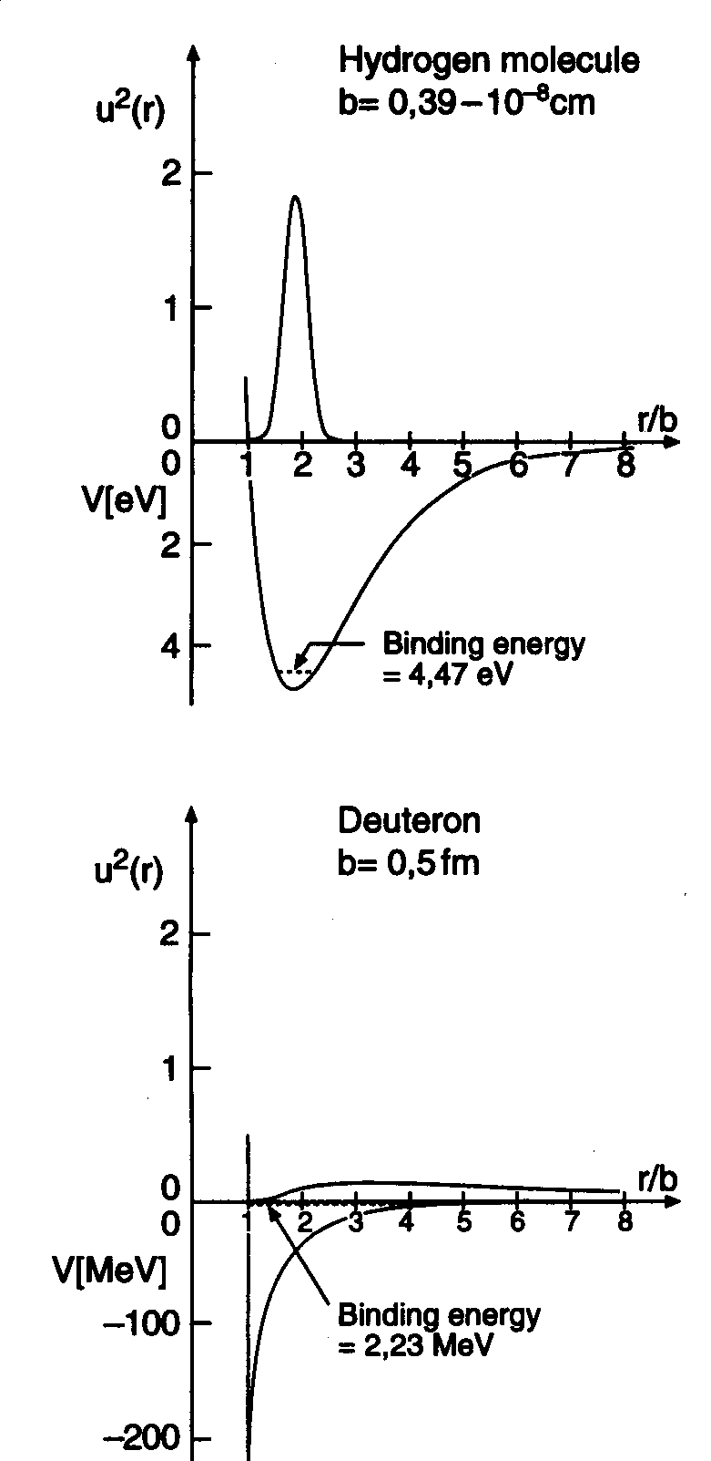
Deuteron
Binding energy | 2.225 MeV
Spin, parity | 1⁺
Isospin | 0
Magnetic moment | μ=0.857 μ_{N}
Electric quadrupole moment | Q=0.282 e fm²
produced by tensor force!

Slide 11
Nucleon-Nucleon Interaction
NN, NNN, NNNN,…, forces
GFMC calculations tell us that:
short-range
three-body

Slide 12
Few-nucleon systems
(theoretical struggle)
A=2: many years ago…
³H: 1984 (1% accuracy)
  Faddeev
  Schroedinger
³He: 1987
⁴He: 1987
⁵He: 1994 (n-α resonance)
A=6,7,..12: 1995-2014

Slide 13
Happy the man who has been able to discern the cause of things
Virgil, Georgica
Theories
Models
A first rate theory predicts
A second rate theory forbids
A third rate theory explains after the facts
Alexander I. Kitaigorodskii

Slide 14

Weinberg’s Laws of Progress in Theoretical Physics
From: “Asymptotic Realms of Physics” (ed. by Guth, Huang, Jaffe, MIT Press, 1983)
First Law: “The conservation of Information” (You will get nowhere by churning equations)
Second Law: “Do not trust arguments based on the lowest order of perturbation theory”
Third Law: “You may use any degrees of freedom you like to describe a physical system, but if you use the wrong ones, you’ll be sorry!”

Slide 15
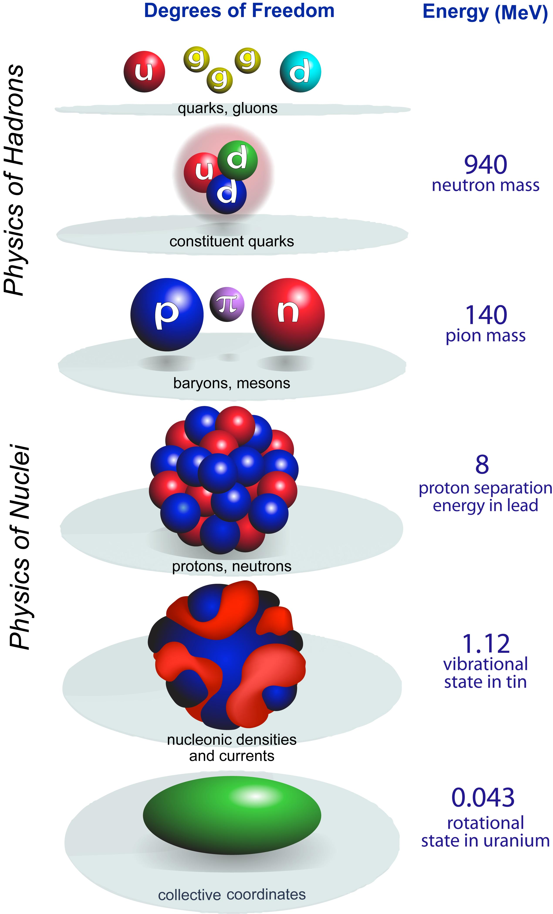

How are nuclei made?
Origin of elements, isotopes
LQCD
scale
separation
Hot and dense quark-gluon matter
Hadron structure
quark
models
Resolution
Hadron-Nuclear interface
ab initio
Nuclear structure
Nuclear reactions
New standard model
CI
Effective Field Theory
DFT
Applications of nuclear science
collective
models
To explain, predict, use…
Notes:
Degrees of freedom of the strongly-interacting many-body problem

Slide 16

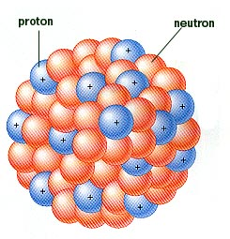
Modeling the Atomic Nucleus
Theoretical bag of tricks…

Slide 17
The Nuclear Many-Body Problem
coupled integro-differential equations in 3A dimensions

Slide 18
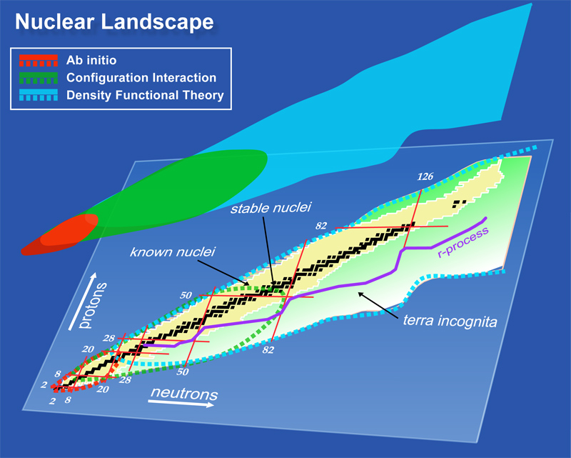
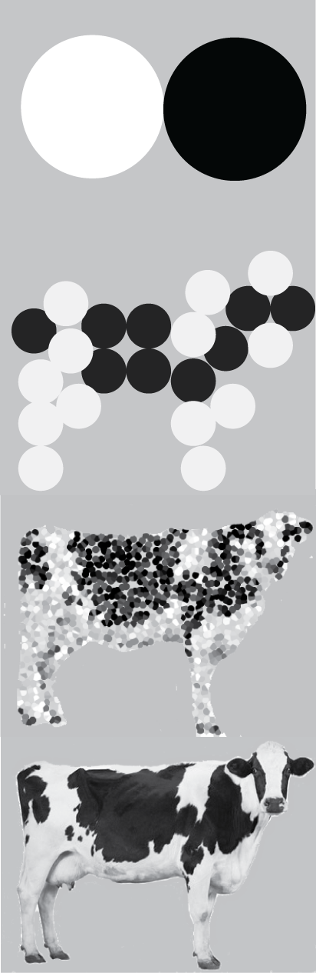
How to explain the nuclear landscape from the bottom up? Theory roadmap
dimension of the problem

Slide 19
Theory of nuclei is demanding
rooted in QCD
insights from EFT
many-body interactions
in-medium renormalization
microscopic functionals
low-energy coupling constants optimized to data
crucial insights from exotic nuclei
Input
Forces, operators
¹¹Li
¹⁰⁰Sn
²⁴⁰Pu
²⁹⁸U
Many-body
dynamics
Open
channels
many-body techniques
  direct ab initio schemes
  symmetry breaking and restoration
high-performance computing
interdisciplinary connections
nuclear structure impacted by couplings to reaction and decay channels
clustering, alpha decay, and fission still remain major challenges for theory
unified picture of structure and reactions

Slide 20
Illustrative physics examples

Slide 21
Ab initio theory for light nuclei and nuclear matter
Ab initio: QMC, NCSM, CCM,…
(nuclei, neutron droplets, nuclear matter)
Input:
Excellent forces based on the phase shift analysis and few-body data
EFT based nonlocal chiral NN and NNN potentials
SRG-softened potentials based on bare NN+NNN interactions
Ab initio input
NN+NNN
interactions
Many body
method
Renormalization
Quantum Monte Carlo (GFMC) ¹²C
No-Core Shell Model ¹⁴F, ¹⁴C
Coupled-Cluster Techniques ¹⁷F, ⁵⁶Ni, ⁶¹Ca
Observables
Direct comparison with experiment
Pseudo-data to inform theory

Slide 22
Green’s Function Monte Carlo
(imaginary-time method)
Trial wave function
Other methods:
Faddeev-Yakubovsky method
Hyperspherical harmonics method
Coupled-cluster expansion method, exp(S)
Cluster approaches (resonating group method)
No-core shell model
Lattice methods

Slide 23
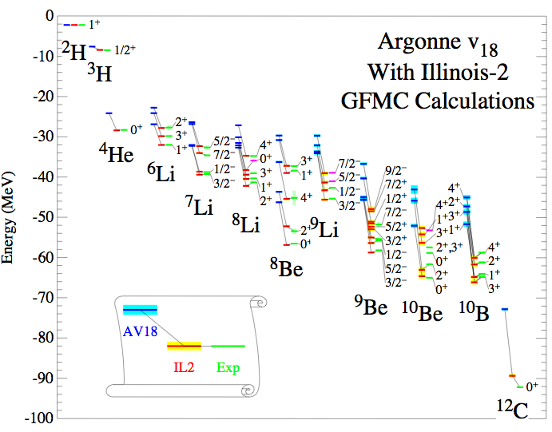
Ab initio: Examples
GFMC: S. Pieper, ANL
1-2% calculations of A = 6 – 12 nuclear energies are possible
excited states with the same quantum numbers computed

Slide 24
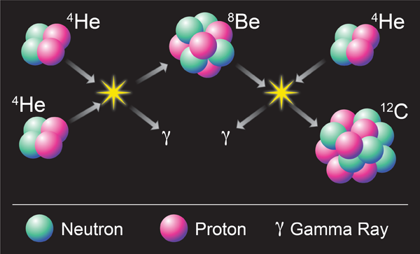
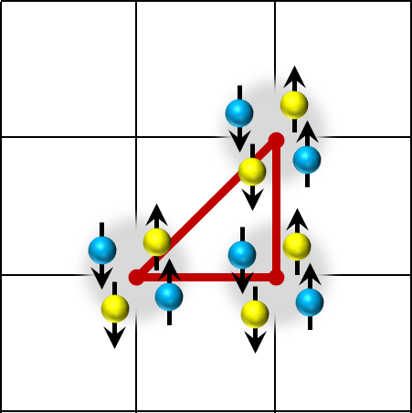
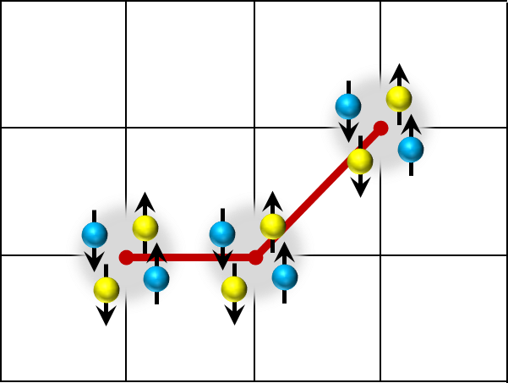
¹²C: ground state and Hoyle state
state-of-the-art computing
Wiringa et al. Phys. Rev. C 89, 024305 (2014); A. Lovato et al., Phys. Rev. Lett. 112, 182502 (2014)
The ADLB (Asynchronous Dynamic Load-Balancing) version of GFMC was used to make calculations of ¹²C with a complete Hamiltonian (two- and three-nucleon potential AV18+IL7) on 32,000 processors of the Argonne BGP. The computed binding energy is 93.5(6) MeV compared to the experimental value of 92.16 MeV and the point rms radius is 2.35 fm vs 2.33 from experiment.
Pieper et al., QMC
Epelbaum et al., Phys. Rev. Lett. 109, 252501 (2012). Lattice EFT
Lahde et al., Phys. Lett. B 732, 110 (2014).
-91.7(2)

Slide 25
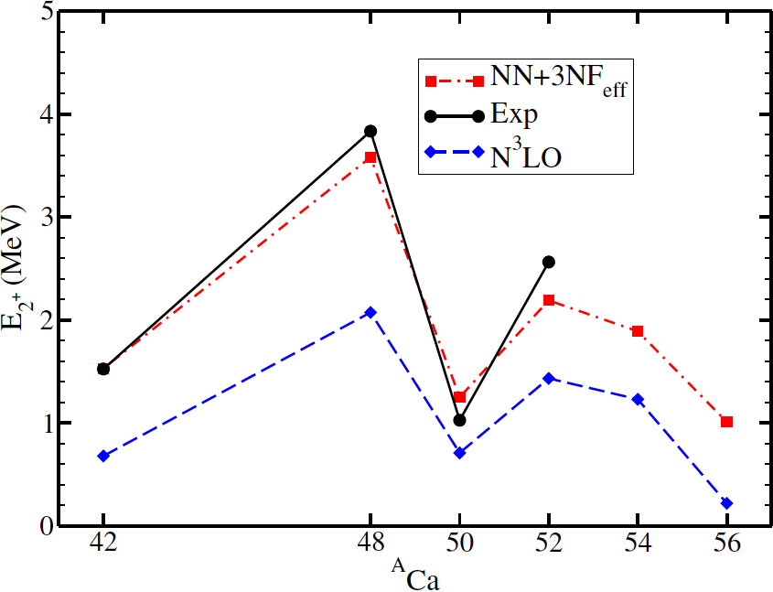
The frontier: neutron-rich calcium isotopes
probing nuclear forces and shell structure in a neutron-rich medium
⁵⁴Ca: 20 protons, 34 neutrons
⁵²Ca mass
TITAN@TRIUMF
Gallant et al, PRL 109, 032506 (2012)
ISOLTRAP@CERN
Wienholtz et al, Nature (2013)
⁵⁴Ca mass
⁵⁴Ca 2⁺
RIBF@RIKEN
Steppenbeck et al
Nature (2013)
CC theory
Hagen et al., PRL109, 032502 (2012)

Slide 26
Ab Initio Path to Heavy Nuclei
Binder et al., arXiv:1312.5685
The first accurate ab initio cupled cluster calculations for heavy nuclei using SRG-evolved chiral interactions. A number of technical hurdles eliminated
Many-body calculations up to ¹³²Sn are now possible with controlled uncertainties on the order of 2%
A first direct validation of chiral Hamiltonians in the regime of heavy nuclei using ab initio techniques.
Future studies will have to involve consistent chiral Hamiltonians at N³LO considering initial and SRG-induced 4N interactions and provide an exploration of other observables.

Slide 27
Configuration interaction techniques
light and heavy nuclei
detailed spectroscopy
quantum correlations (lab-system description)
Input: configuration space + forces
Method
NN+NNN
interactions
Renormalization
Diagonalization
Truncation+diagonalization
Monte Carlo
Matrix elements
fitted to experiment
Observables
Direct comparison with experiment
Pseudo-data to inform reaction theory and DFT

Slide 28
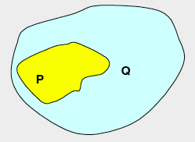
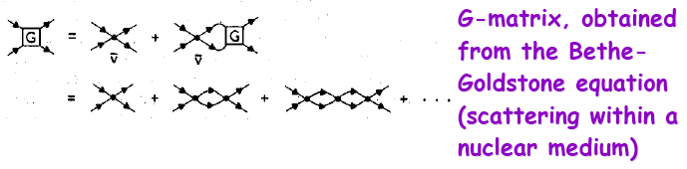
Nuclear shell model
One-body
Hamiltonian
Residual
interactioni
Construct basis states with good (J_{z}, T_{z}) or (J,T)
Compute the Hamiltonian matrix
Diagonalize Hamiltonian matrix for lowest eigenstates
Number of states increases dramatically with particle number
Can we get around this problem? Effective interactions in truncated spaces (P-included, finite; Q-excluded, infinite)
Residual interaction (G-matrix) depends on the configuration space. Effective charges
Breaks down around particle drip lines

Slide 29
Microscopic valence-space Shell Model Hamiltonian
Coupled Cluster Effective Interaction
(valence cluster expansion)
In-medium SRG Effective Interaction
S.K. Bogner et al., arXiv:1402.1407
G.R. Jansen et al., arXiv:1402.2563

Slide 30

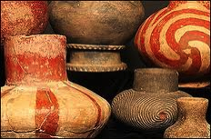
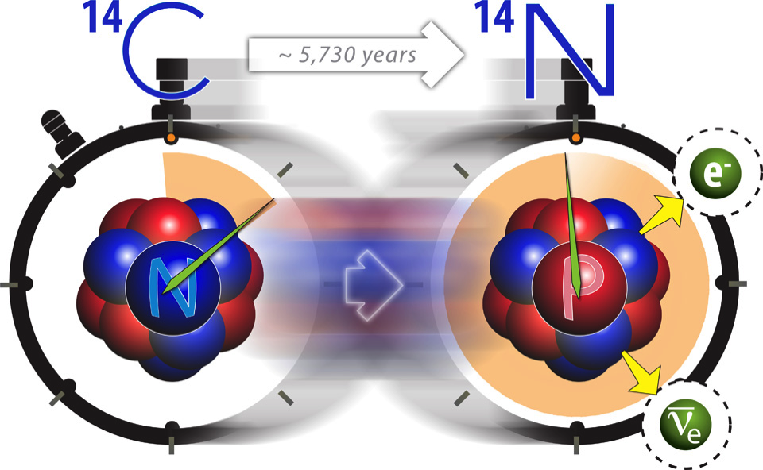

Anomalous Long Lifetime of ¹⁴C
Determine the microscopic origin of the suppressed β-decay rate: 3N force
Maris et al., PRL 106, 202502 (2011)
Dimension of matrix solved for 8 lowest states ~ 10⁹ Solution took ~ 6 hours on 215,000 cores on Cray XT5 Jaguar at ORNL

Slide 31
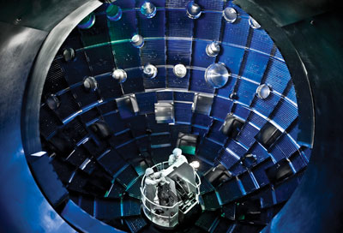
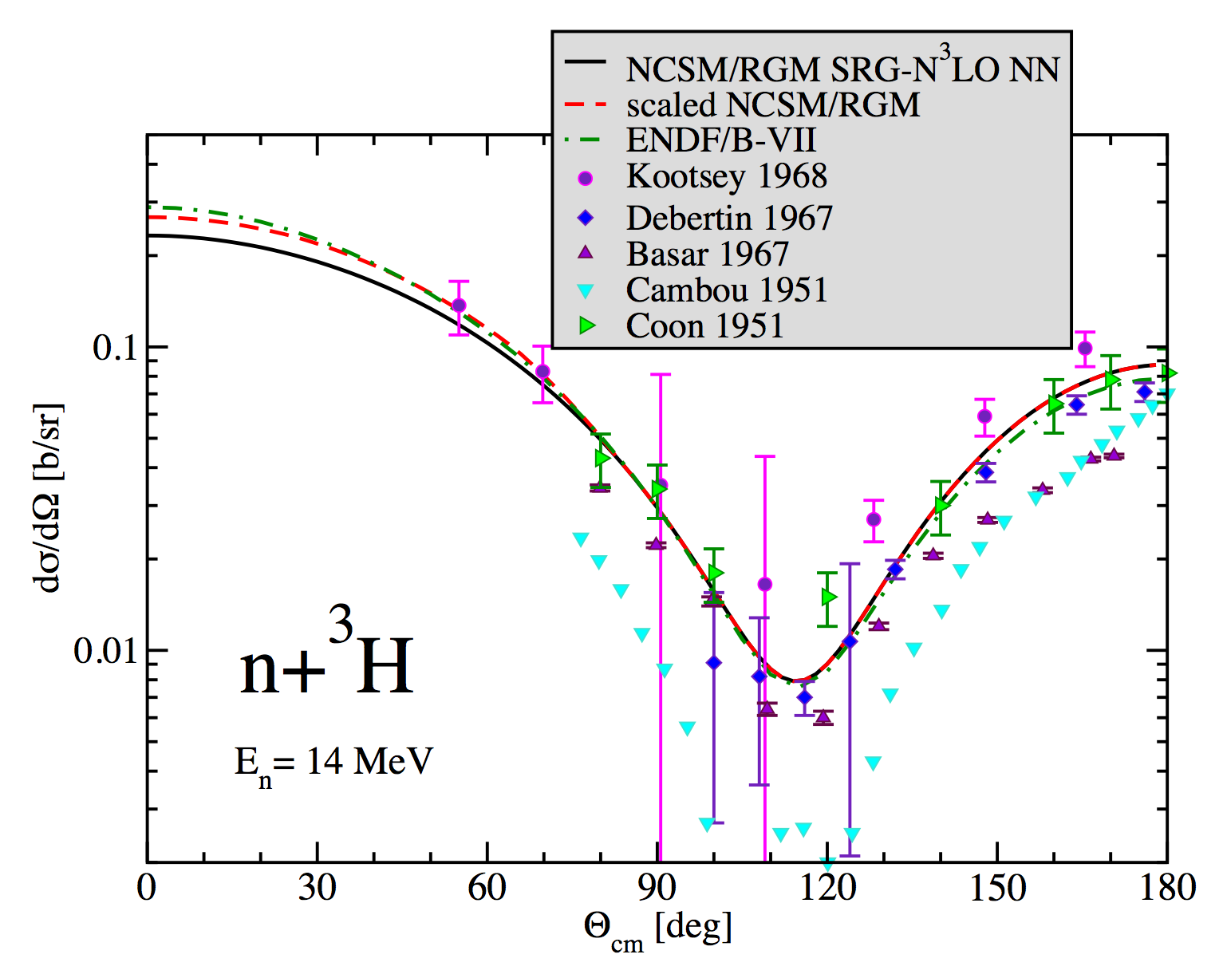
Fusion of Light Nuclei
Computational nuclear physics enables us to reach into regimes where experiments and analytic theory are not possible, such as the cores of fission reactors or hot and dense evolving environments such as those found in inertial confinement fusion environment.
NIF
Ab initio theory reduces uncertainty due to conflicting data
The n-³H elastic cross section for 14 MeV neutrons, important for NIF, was not known precisely enough.
Delivered evaluated data with required 5% uncertainty and successfully compared to measurements using an Inertial Confinement Facility
“First measurements of the differential cross sections for the elastic n-²H and n-³H scattering at 14.1 MeV using an Inertial Confinement Facility”, by J.A. Frenje et al., Phys. Rev. Lett. 107, 122502 (2011)
http://physics.aps.org/synopsis-for/10.1103/PhysRevLett.107.122502

Slide 32
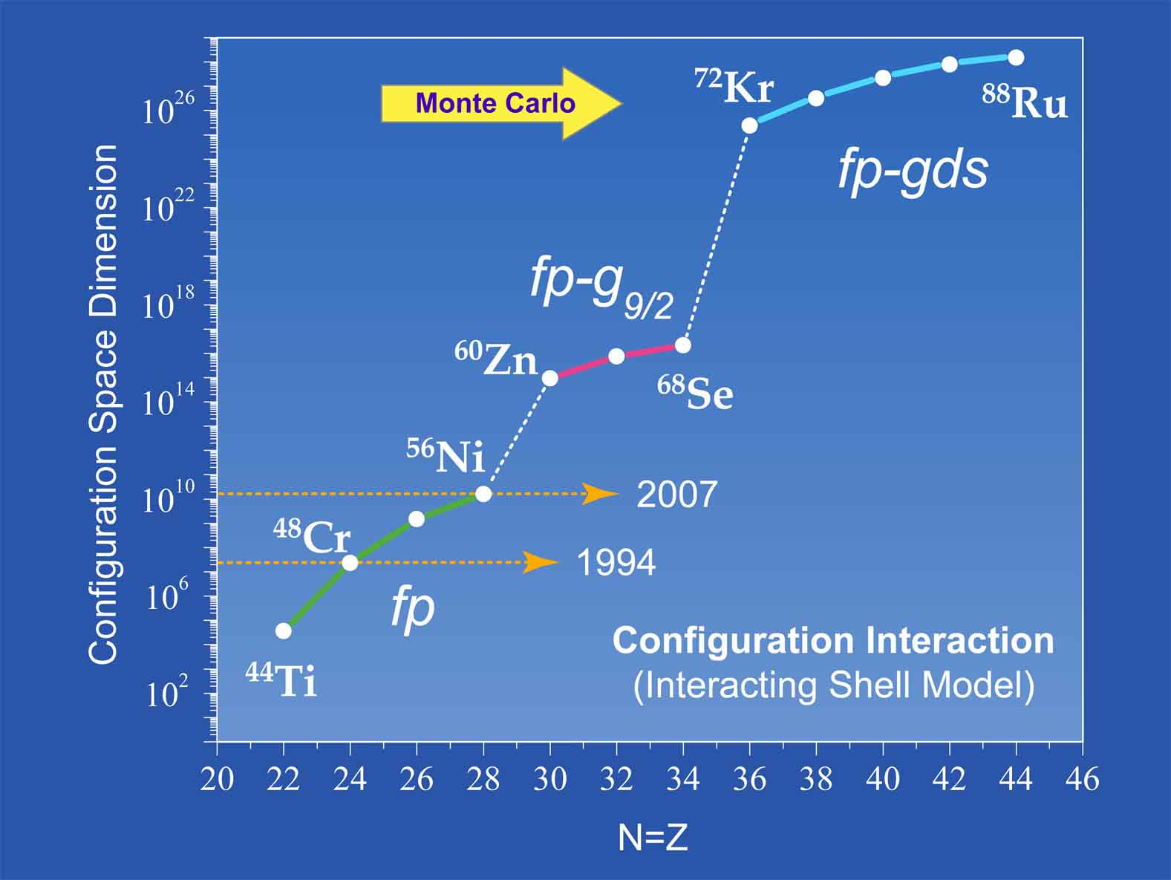

Slide 33
Nuclear Density Functional Theory and Extensions
Input
Technology to calculate observables
Global properties
Spectroscopy
DFT Solvers
Functional form
Functional optimization
Estimation of theoretical errors
NN+NNN
interactions
Density Matrix
Expansion
Density dependent
interactions
Energy Density
Functional
Optimization
Fit-observables
experiment
pseudo data
DFT variational principle
HF, HFB (self-consistency)
Symmetry breaking
Symmetry restoration
Multi-reference DFT (GCM)
Time dependent DFT (TDHFB)
two fermi liquids
self-bound
superfluid (ph and pp channels)
self-consistent mean-fields
broken-symmetry generalized product states
Observables
Direct comparison with experiment
Pseudo-data for reactions and astrophysics

Slide 34
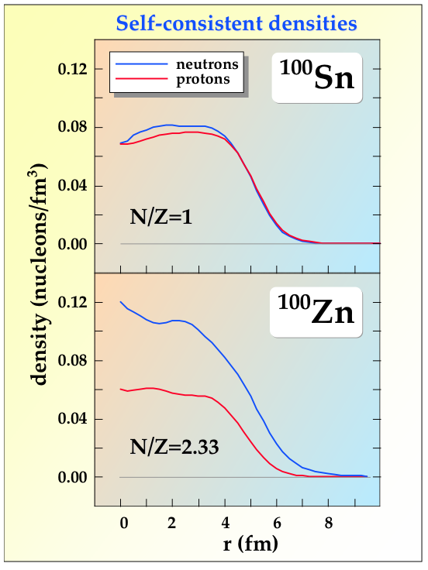
Mean-Field Theory ⇒ Density Functional Theory
Degrees of freedom: nucleonic densities
Nuclear DFT
two fermi liquids
self-bound
superfluid
mean-field ⇒ one-body densities
zero-range ⇒ local densities
finite-range ⇒ gradient terms
particle-hole and pairing channels
Has been extremely successful. A broken-symmetry generalized product state does surprisingly good job for nuclei.

Slide 35
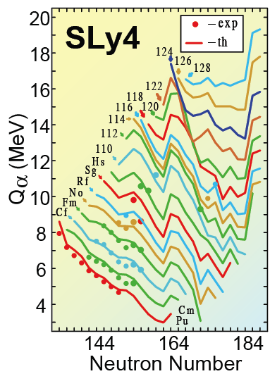
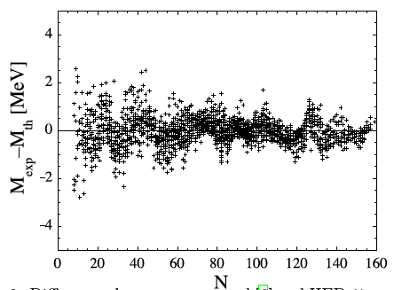
Examples: Nuclear Density Functional Theory
Traditional (limited) functionals provide quantitative description
BE differences
Mass table
δm=0.581 MeV
Goriely, Chamel, Pearson: HFB-17
Phys. Rev. Lett. 102, 152503 (2009)
Cwiok et al., Nature, 433, 705 (2005)

Slide 36
Example: Large Scale Mass Table Calculations
HFB+LN mass table, HFBTHO
5,000 even-even nuclei, 250,000 HFB runs, 9,060 processors – about 2 CPU hours
Full mass table: 20,000 nuclei, 12M configurations — full JAGUAR
Notes:
embarrassingly parallel computing

Slide 37
Description of observables and model-based extrapolation
Systematic errors (due to incorrect assumptions/poor modeling)
Statistical errors (optimization and numerical errors)
Erler et al., Nature (2012)

Slide 38
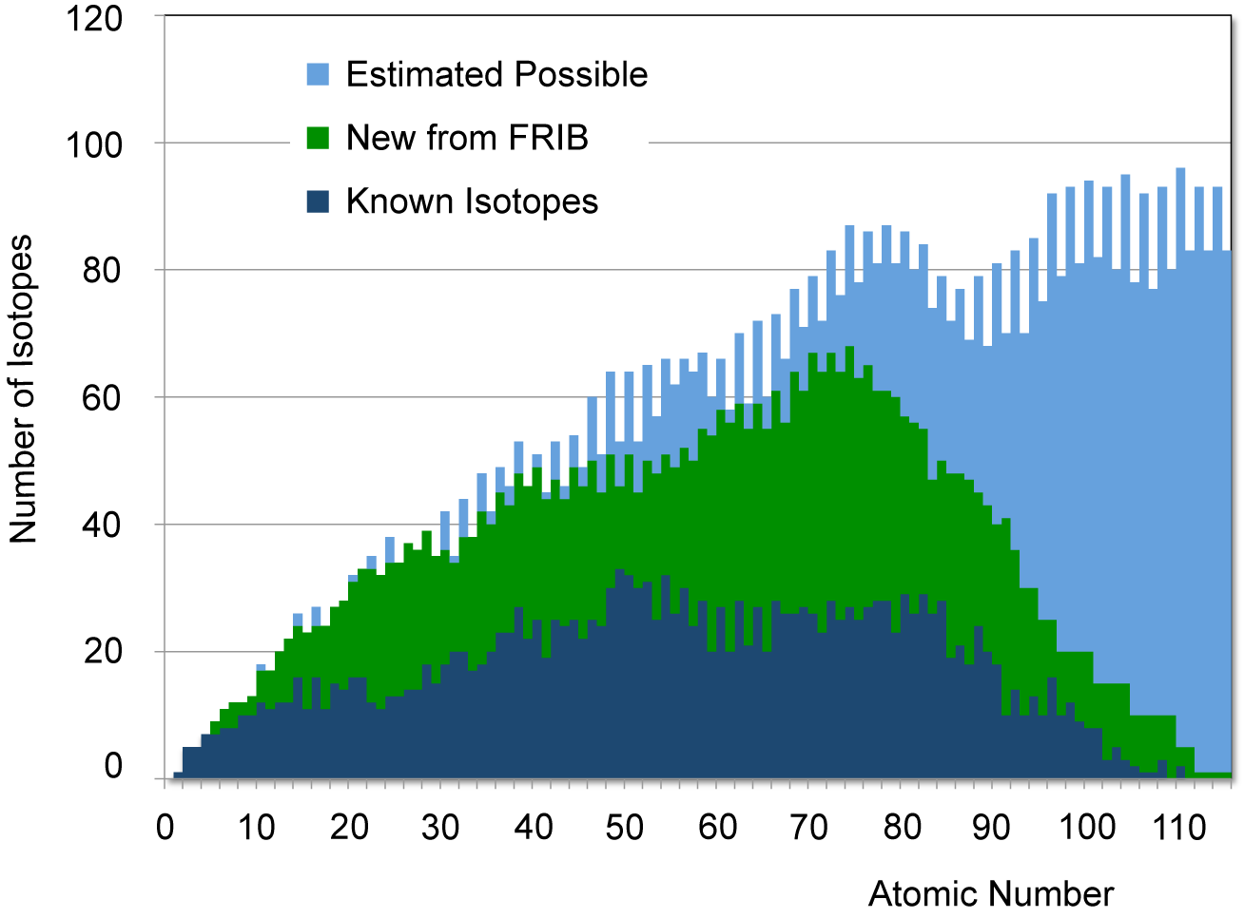
Quantified Nuclear Landscape
288
~3,000
Asymptotic freedom ?
DFT
FRIB
current
from B. Sherrill
How many protons and neutrons can be bound in a nucleus?
Erler et al.
Nature 486, 509 (2012)
Literature: 5,000-12,000
Skyrme-DFT: 6,900±500_{syst}

Slide 39
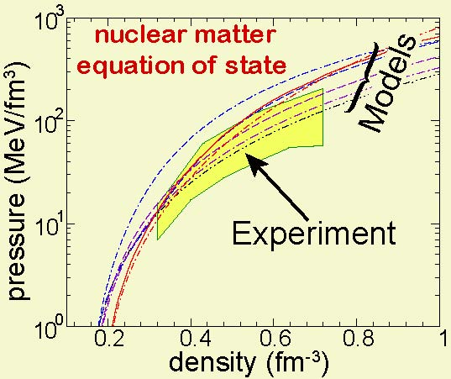
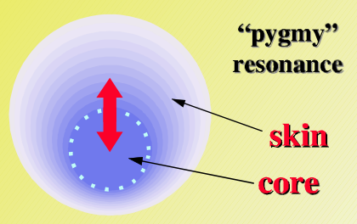
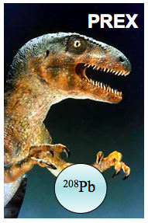
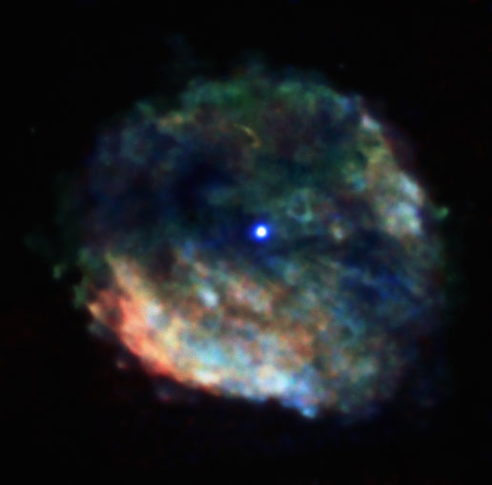
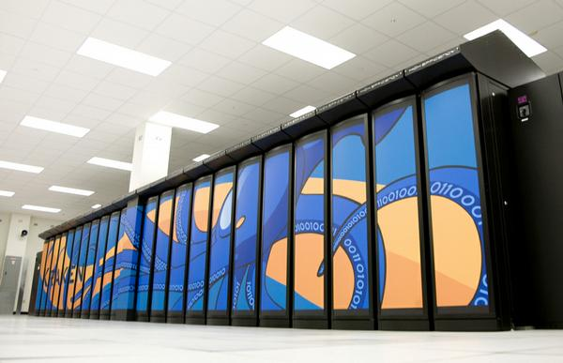

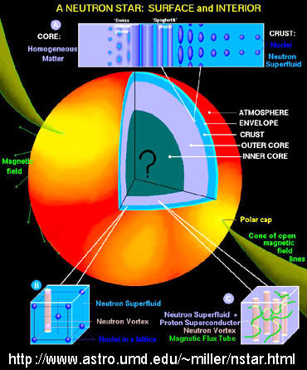

Quest for understanding the neutron-rich matter on Earth and in the Cosmos
RNB
facilities
Nuclear matter equation of state
Nuclear observables
Nuclear
interactions
Many-body theory
Neutron star crust
Astronomical observables
Microphysics
(transport,…)

Slide 40
From nuclei to neutron stars (a multiscale problem)
Gandolfi et al. PRC85, 032801 (2012)
J. Erler et al., PRC 87, 044320 (2013)
The covariance ellipsoid for the neutron skin R_{skin} in ²⁰⁸Pb and the radius of a 1.4M⊙ neutron star.
The mean values are: R(1.4M⊙ )=12 km and R_{skin}= 0.17 fm.
Major uncertainty: density dependence of the symmetry energy. Depends on T=3/2 three-nucleon forces
Notes:
Tolman–Oppenheimer–Volkoff equation: describes a spherically symmetric isotropic material in static gravitational equilibrium, as modeled by general relativity. Main input: EOS

