Slide 1
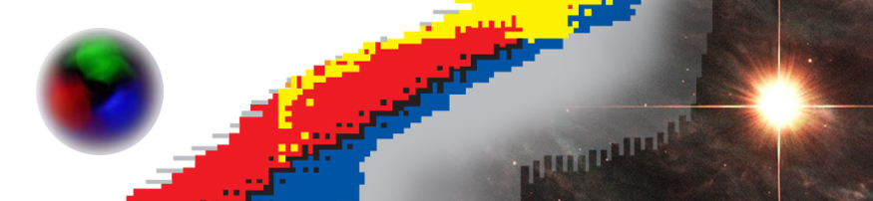

Nuclear structure II (global properties, shells)
Witek Nazarewicz (UTK/ORNL)
National Nuclear Physics Summer School 2014
William & Mary, VA
Global properties of atomic nuclei
Shell structure
Nucleon-nucleon interaction
Deuteron, Light nuclei

Slide 2
Global properties of atomic nuclei

Slide 3
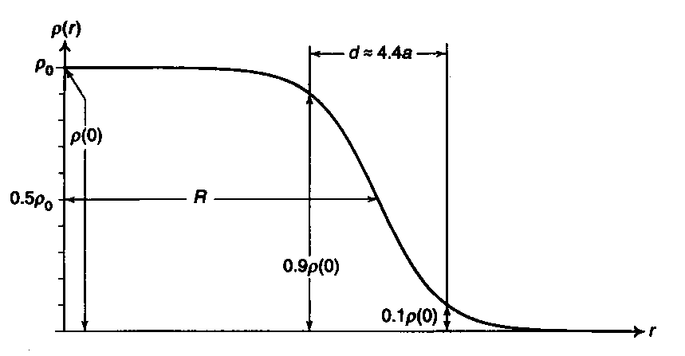
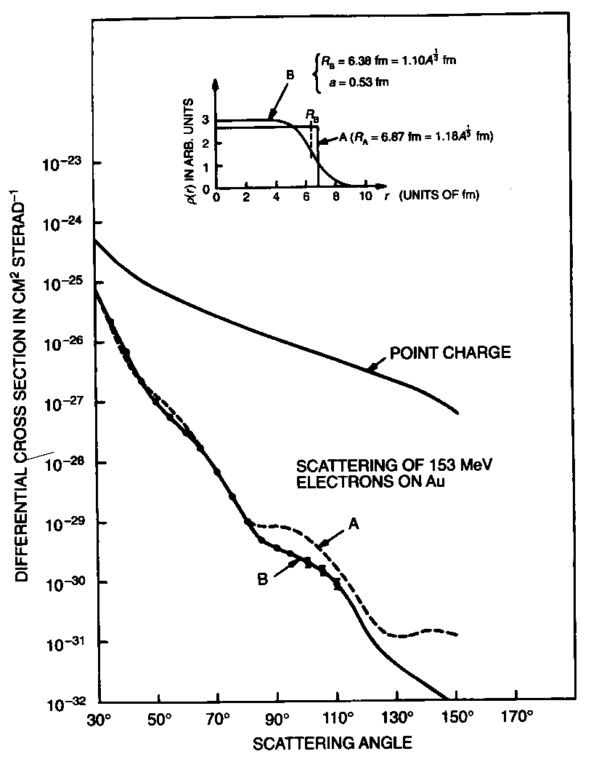
Sizes
homogenous charge
distribution
finite diffuseness

Slide 4
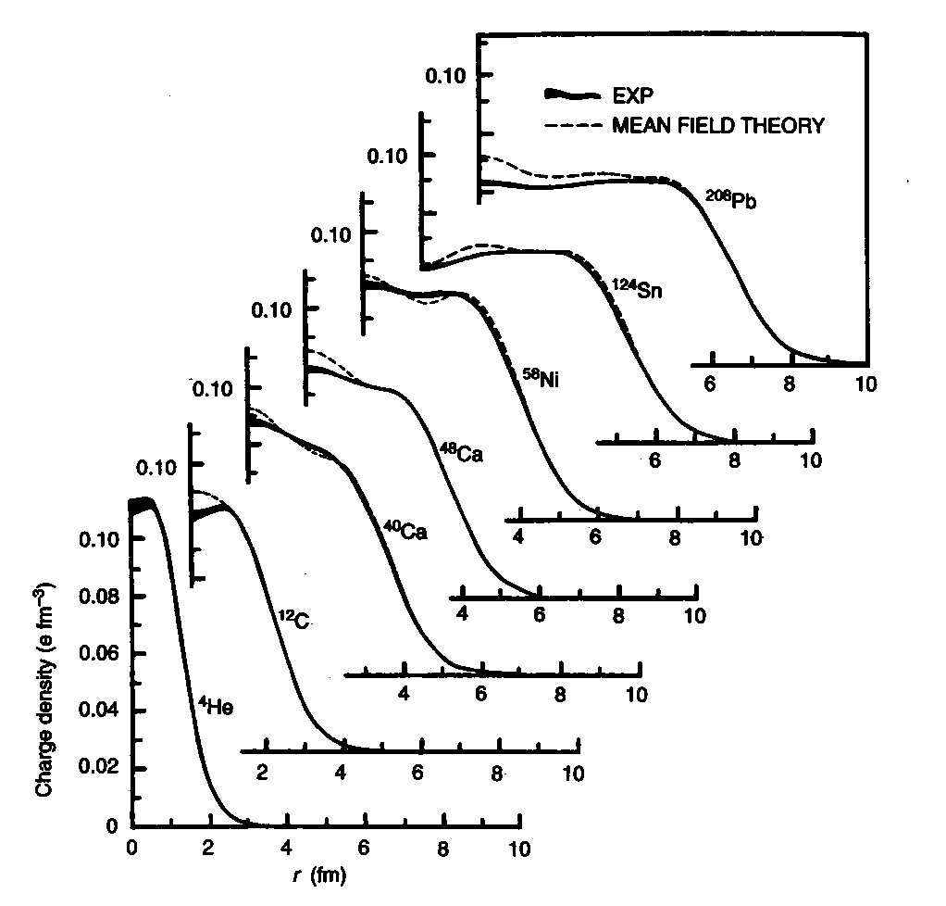
Calculated and measured densities

Slide 5
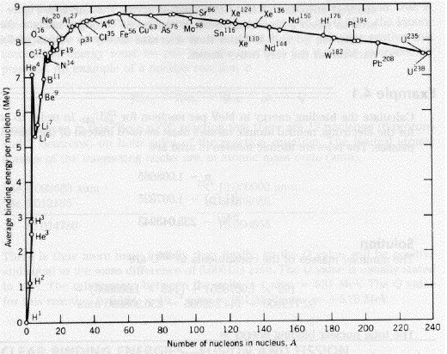
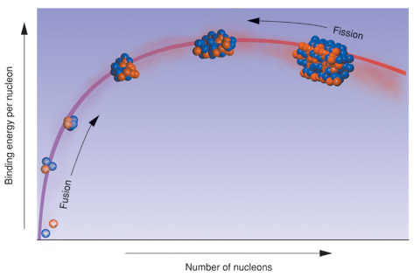
Binding
The binding energy contributes significantly (~1%) to the mass of a nucleus. This implies that the constituents of two (or more) nuclei can be rearranged to yield a different and perhaps greater binding energy and thus points towards the existence of nuclear reactions in close analogy with chemical reactions amongst atoms.
B is positive for a bound system!

Slide 6
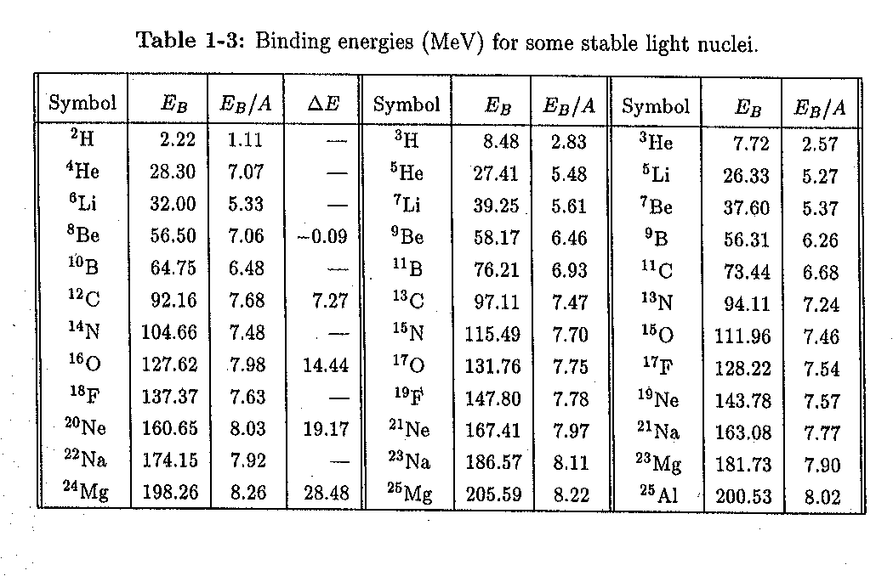
The sharp rise of B/A for light nuclei comes from increasing the number of nucleonic pairs. Note that the values are larger for the 4n nuclei (α-particle clusters!). For those nuclei, the difference
divided by the number of alpha-particle pairs, n(n-1)/2, is roughly constant (around 2 (MeV). This is nice example of the saturation of nuclear force. The associated symmetry is known as SU(4), or Wigner supermultiplet symmetry.
⁴He

Slide 7
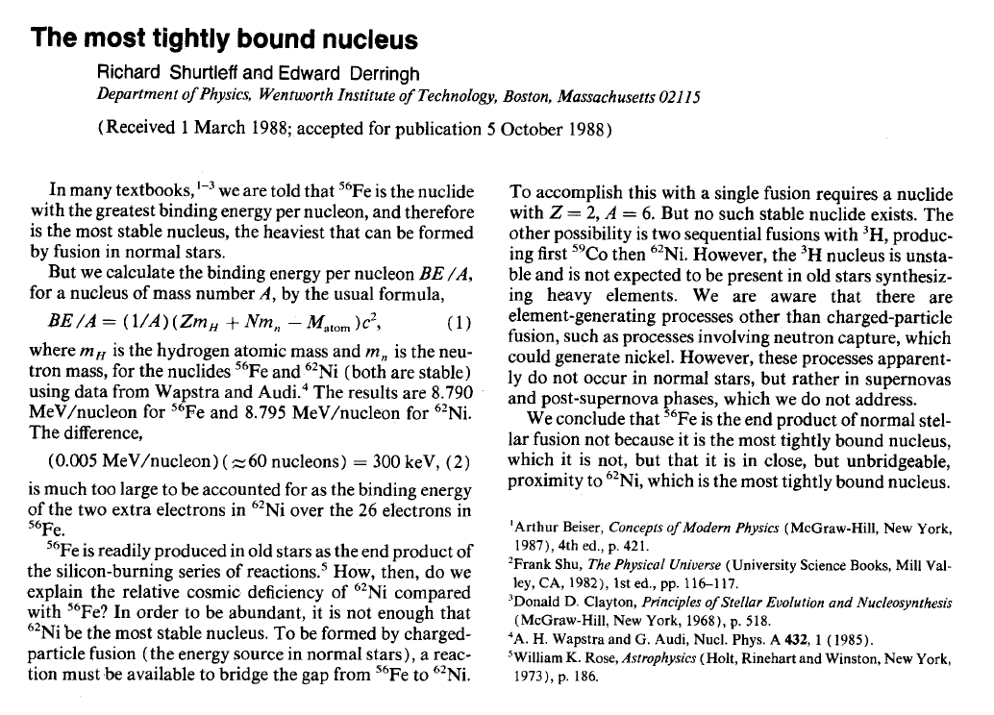
American Journal of Physics -- June 1989 -- Volume 57, Issue 6, p. 552

Slide 8
Binding (summary)
For most nuclei, the binding energy per nucleon is about 8MeV.
Binding is less for light nuclei (these are mostly surface) but there are peaks for A in multiples of 4. (But note that the peak for ⁸Be is slightly lower than that for ⁴He.
The most stable nuclei are in the A~60 mass region
Light nuclei can gain binding energy per nucleon by fusing; heavy nuclei by fissioning.
The decrease in binding energy per nucleon for A>60 can be ascribed to the repulsion between the (charged) protons in the nucleus: the Coulomb energy grows in proportion to the number of possible pairs of protons in the nucleus Z(Z-1)/2
The binding energy for massive nuclei (A>60) thus grows roughly as A; if the nuclear force were long range, one would expect a variation in proportion to the number of possible pairs of nucleons, i.e. as A(A-1)/2. The variation as A suggests that the force is saturated; the effect of the interaction is only felt in a neighborhood of the nucleon.

Slide 9
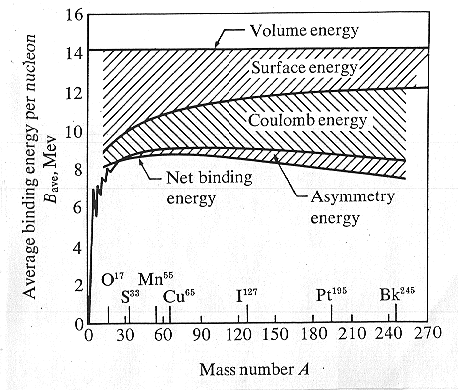
Nuclear liquid drop
The semi-empirical mass formula, based on the liquid drop model, considers five contributions to the binding energy (Bethe-Weizacker 1935/36)
15.68
-18.56
-28.1
-0.717
pairing term
Leptodermous expansion

Slide 10
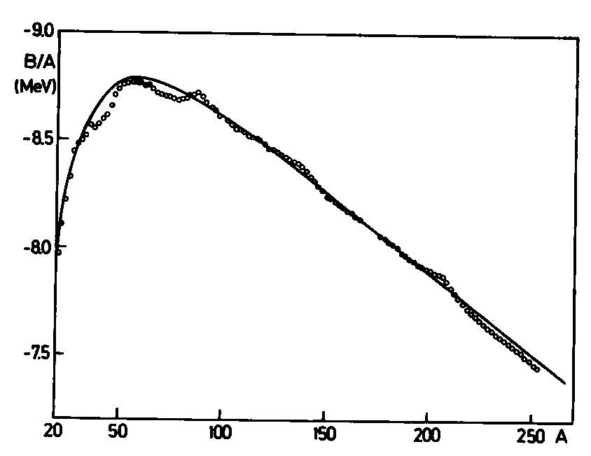
The semi-empirical mass formula, based on the liquid drop model, compared to the data

Slide 11
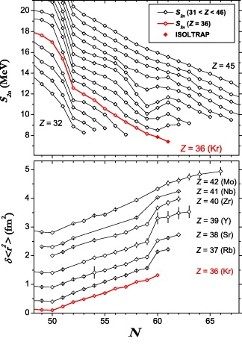

Slide 12
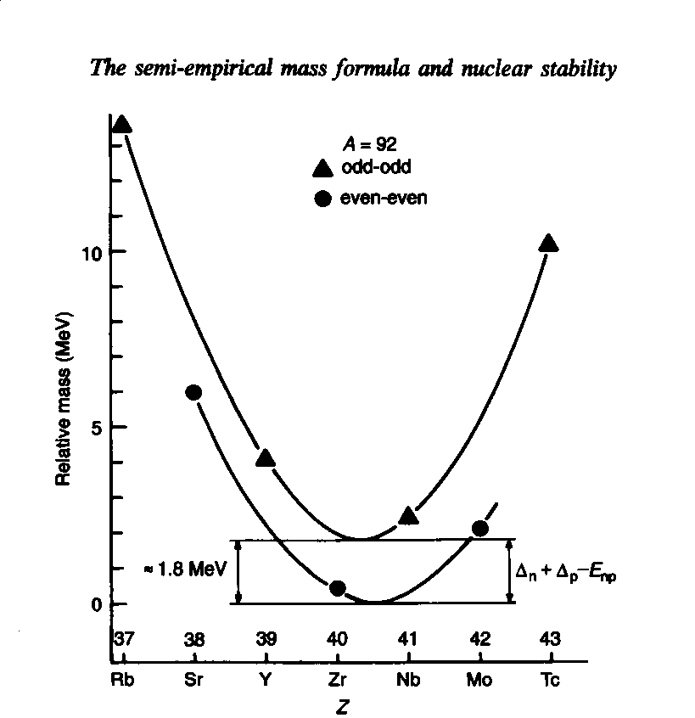
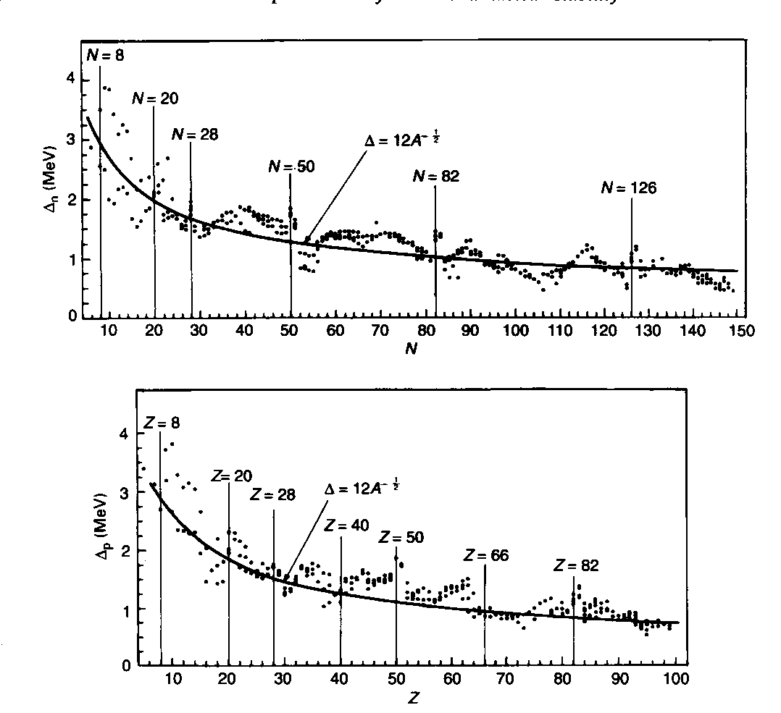
Pairing energy
A common phenomenon in mesoscopic systems!

Slide 13
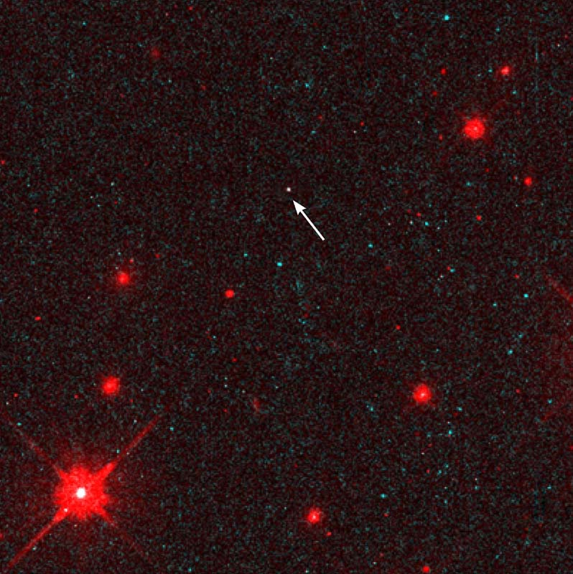
Neutron star, a bold explanation
A lone neutron star, as seen by NASA's Hubble Space Telescope
Let us consider a giant neutron-rich nucleus. We neglect Coulomb, surface, and pairing energies. Can such an object exist?
limiting condition
⊙
More precise calculations give M(min) of about 0.1 solar mass (M⊙). Must neutron stars have
⊙

Slide 14
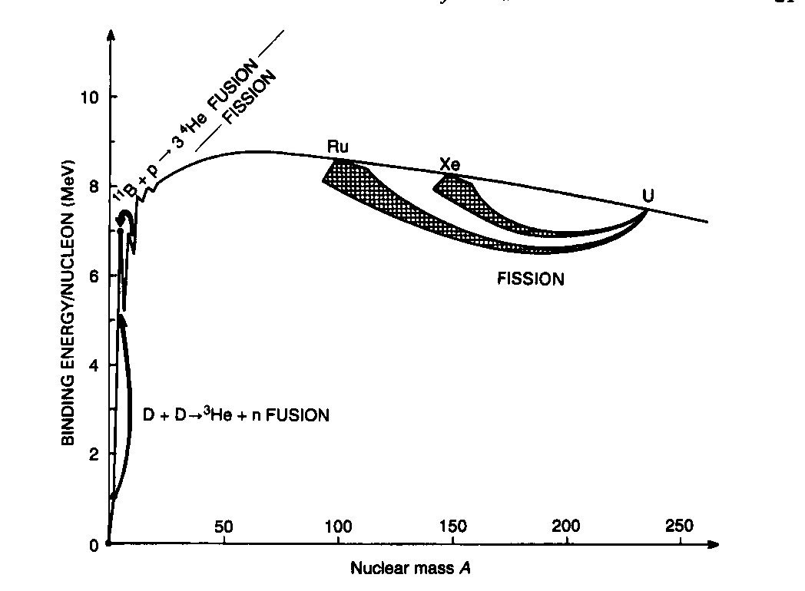
Fission
All elements heavier than A=110-120 are fission unstable!
But… the fission process is fairly unimportant for nuclei with A<230. Why?

Slide 15
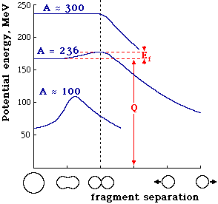
Deformed liquid drop (Bohr & Wheeler, 1939)
fissibility
parameter
The classical droplet stays
stable and spherical for x<1.
For x>1, it fissions immediately.
For ²³⁸U, x=0.8.

Slide 16
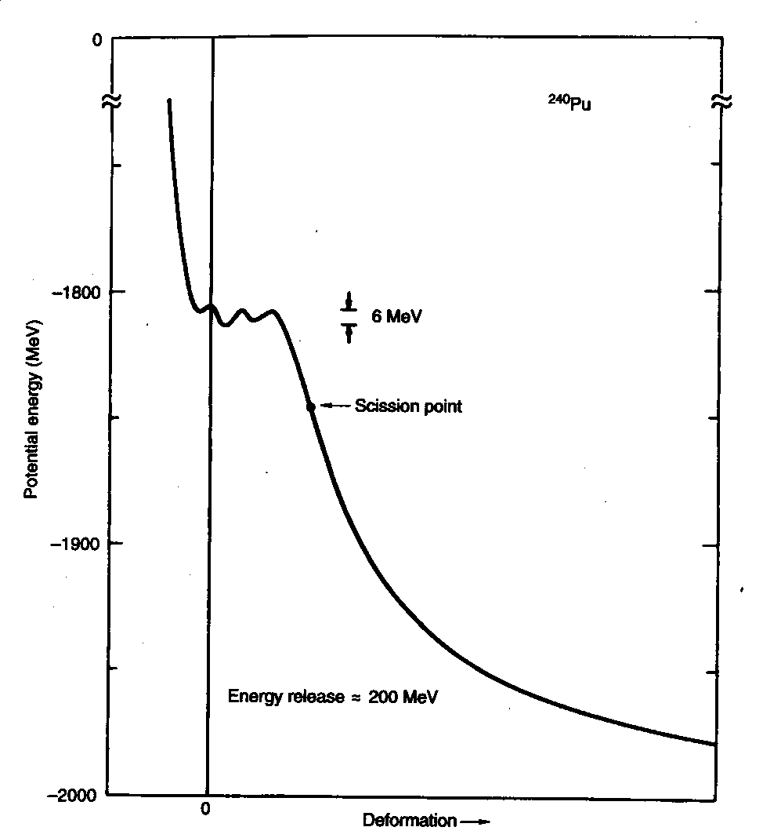
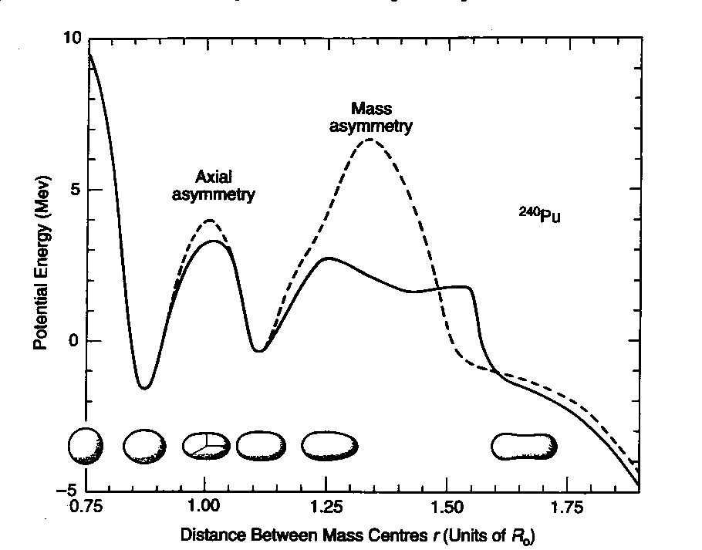
²⁴⁰Pu
1938 - Hahn & Strassmann
1939 Meitner & Frisch
1939 Bohr & Wheeler
1940 Petrzhak & Flerov
Realistic
calculations

Slide 17
Nuclear shapes
The first evidence for a non-spherical nuclear shape came from the observation of a quadrupole component in the hyperfine structure of optical spectra. The analysis showed that the electric quadrupole moments of the nuclei concerned were more than an order of magnitude greater than the maximum value that could be attributed to a single proton and suggested a deformation of the nucleus as a whole.
Schüler, H., and Schmidt, Th., Z. Physik 94, 457 (1935)
Casimir, H. B. G., On the Interaction Between Atomic Nuclei and Electrons, Prize Essay, Taylor’s Tweede Genootschap, Haarlem (1936)
The question of whether nuclei can rotate became an issue already in the very early days of nuclear spectroscopy
Thibaud, J., Comptes rendus 191, 656 ( 1930)
Teller, E., and Wheeler, J. A., Phys. Rev. 53, 778 (1938)
Bohr, N., Nature 137, 344 ( 1936)
Bohr, N., and Kalckar, F., Mat. Fys. Medd. Dan. Vid. Selsk. 14, no, 10 (1937)

Slide 18
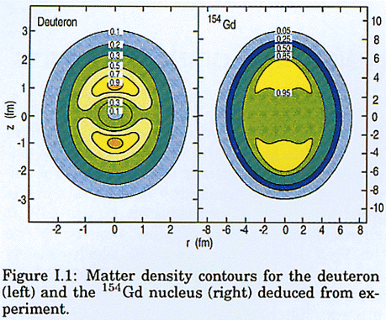
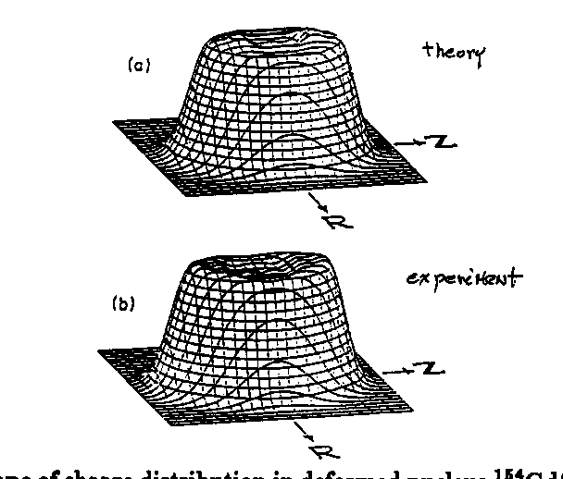
Theory: Hartree-Fock
experiment: (e,e’) Bates
Shape of a charge distribution in ¹⁵⁴Gd

Slide 19
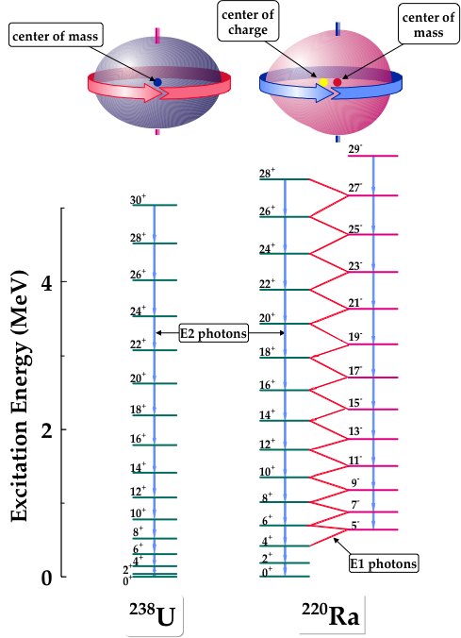

Slide 21
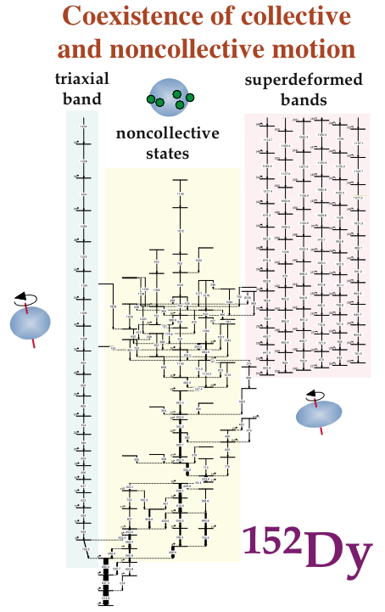
E
fission/fusion
exotic decay
heavy ion coll.
Q₀
Q
E
shape
coexistence
Q₁
Q₂
Q

Slide 22
Nucleonic Shells

Slide 23
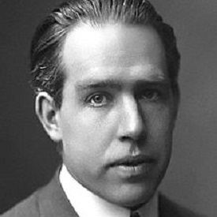
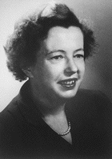
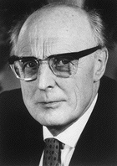

1949
1912
electronic shells of the atom
nucleonic
shells of
the nucleus
Nobel Prize 1922
54
Xe
Nobel Prize 1963
126
3p_{1/2}
Bohr’s picture still serves as an elucidation of the physical and chemical properties of the elements.
5p
2f_{5/2}
4d
5s
1i_{13/2}
36
Kr
3p_{3/2}
4p
1h_{9/2}
3d
2f_{7/2}
noble gases
(closed shells)
4s
magic nuclei
(closed shells)
82
18
Ar
2d_{3/2}
3p
1h_{11/2}
3s
3s_{1/2}
1g_{7/2}
10
Ne
2d_{5/2}
2p
50
We know now that this picture is very incomplete…
2s
1g_{9/2}
Notes:
Goeppert Mayer, J. Hans D. Jensen 1963

Slide 24
s_{1/2}
4s
d_{3/2}
3d
g_{7/2}
d_{5/2}
N=6
2g
j_{15/2}
i_{11/2}
g_{9/2}
1i
126
p_{1/2}
3p
f_{5/2}
i_{13/2}
N=5
2f
p_{3/2}
h_{9/2}
f_{7/2}
1h
82
d_{3/2}
3s
s_{1/2}
h_{11/2}
N=4
2d
g_{7/2}
d_{5/2}
1g
50
g_{9/2}
Harmonic
oscillator
+flat bottom
+spin-orbit

Slide 25
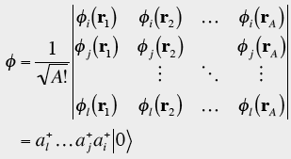
Average one-body Hamiltonian
¹²⁰Sn
Unbound
states
Coulomb
barrier
Discrete
(bound)
states
0
ε_{F}
ε_{F}
Surface
region
n
p
Flat
bottom

Slide 26

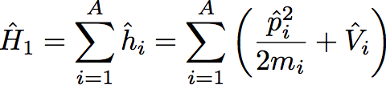

Shell effects and classical periodic orbits
One-body field
Not external (self-bound)
Hartree-Fock
Shells
Product (independent-particle) state is often an excellent starting point
Localized densities, currents, fields
Typical time scale: babyseconds (10⁻²²s)
Closed orbits and s.p. quantum numbers
But…
Nuclear box is not rigid: motion is seldom adiabatic
The walls can be transparent
In weakly-bound nuclei, residual interaction may dominate the picture: shell-model basis does not govern the physics!
Shell-model basis not unique (many equivalent Hartree-Fock fields)

Slide 27
Shell effects and classical periodic orbits
Balian & Bloch, Ann. Phys. 69 (1971) 76
Bohr & Mottelson, Nuclear Structure vol 2 (1975)
Strutinski & Magner, Sov. J. Part. Nucl. 7 (1976) 138
Trace formula, Gutzwiller, J. Math. Phys. 8 (1967) 1979
The action integral for the periodic orbit γ
Condition for
shell structure
Principal shell
quantum number
Distance between shells
(frequency of classical orbit)

Slide 28

Pronounced
shell structure
(quantum numbers)
Shell structure
absent
shell
gap
shell
gap
shell
closed trajectory
(regular motion)
trajectory does not close

Slide 29
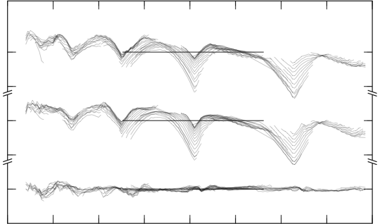
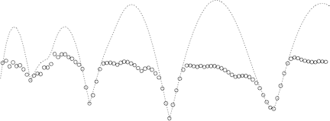
Shells in mesoscopic
systems
10
experiment
P. Moller et al.
experiment
0
theory
-10
Shell Energy (MeV)
Nuclei
theory
0
20
28
-10
50
discrepancy
82
126
0
S. Frauendorf et al.
diff.
-10
1
experiment
20
60
100
Number of Neutrons
0
58
92
138
198
-1
Sodium Clusters
Shell Energy (eV)
1
theory
spherical
clusters
0
Jahn-Teller Effect (1936)
Symmetry breaking and deformed (HF) mean-field
-1
deformed
clusters
50
100
150
200
Number of Electrons

Slide 30
Revising textbooks on nuclear shell model…
N=20
N=28
New gaps N=32,34?
Forces
Many-body
dynamics
Open
channels
from A. Gade
Notes:
Goepper-Meyer, Hans Jensen

Slide 31
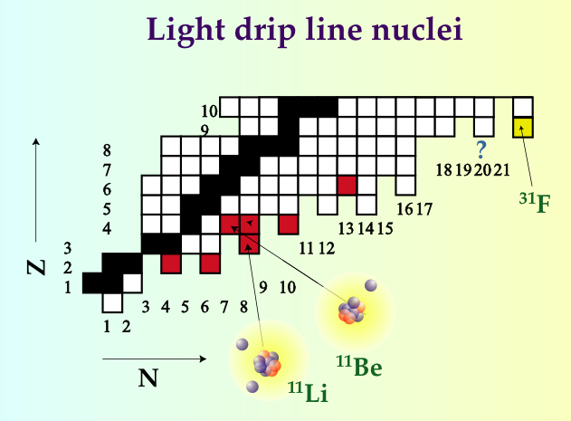
Living on the edge… Correlations and openness
Forces
Many-body
dynamics
Open
channels

Slide 32
Neutron Drip line nuclei
HUGE
D i f f u s e d
PA IR ED
⁴He
⁵He
⁶He
⁷He
⁸He
⁹He
¹⁰He
Notes:
Two neutrons and alpha particle stick together

Slide 33

The Force

Slide 34
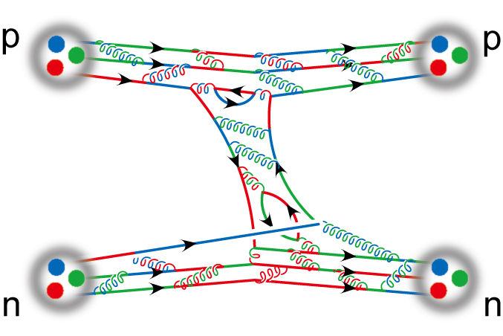
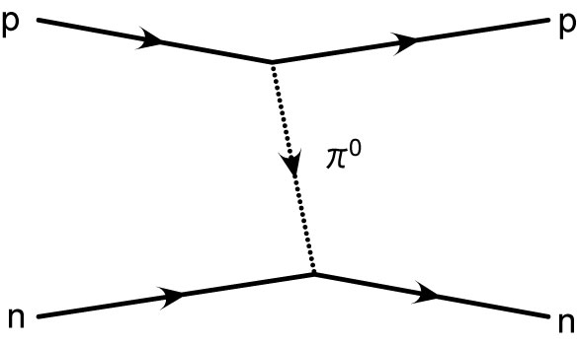
Nuclear force
A realistic nuclear force force: schematic view
Nucleon r.m.s. radius ~0.86 fm
Comparable with interaction range
Half-density overlap at max. attarction
V_{NN} not fundamental (more like inter-molecular van der Waals interaction)
Since nucleons are composite objects, three-and higher-body forces are expected.

Slide 35
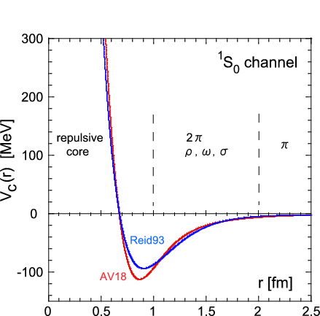
Nucleon-Nucleon interaction (qualitative analysis)
QCD!
There are infinitely many equivalent nuclear potentials!
Repusive core
OPEP
attraction
Reid93 is from
V.G.J.Stoks et al., PRC49, 2950 (1994).
AV16 is from
R.B.Wiringa et al., PRC51, 38 (1995).
quark-gluon structures
overlap
heavy mesons

Slide 36
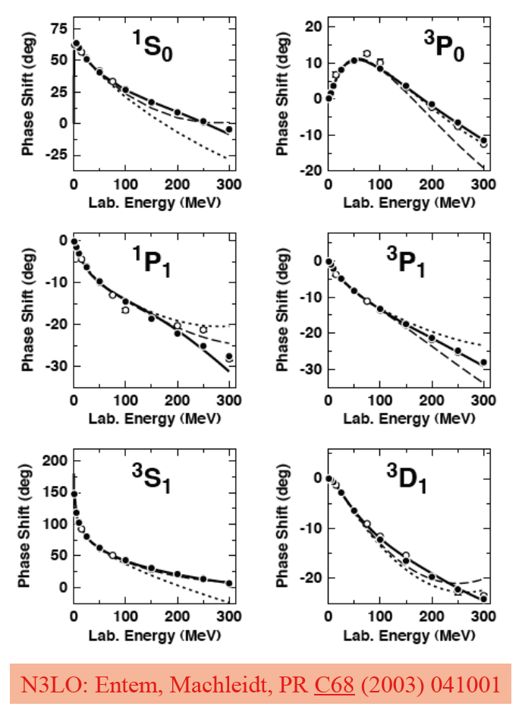
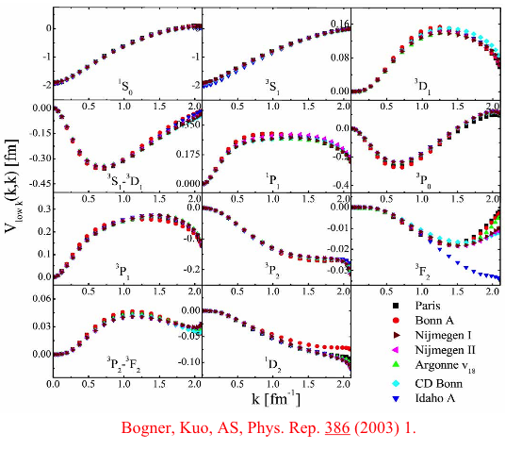
nucleon-nucleon interactions
Effective-field theory potentials
Renormalization group (RG) evolved nuclear potentials
V_{low-k} unifies NN interactions at low energy
N³LO: Entem et al., PRC68, 041001 (2003)
Epelbaum, Meissner, et al.
Bogner, Kuo, Schwenk, Phys. Rep. 386, 1 (2003)

Slide 37
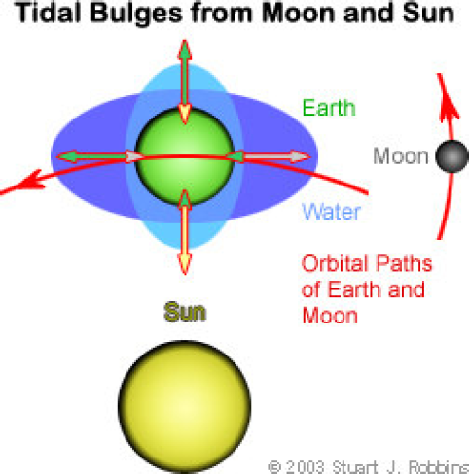
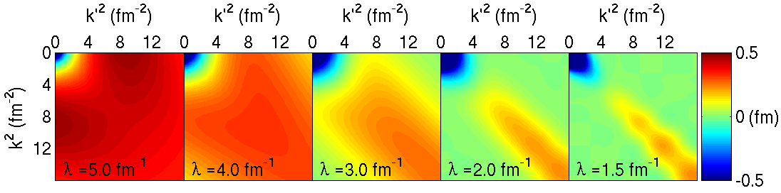
three-nucleon interactions
Three-body forces between protons and neutrons are analogous to tidal forces: the gravitational force on the Earth is not just the sum of Earth-Moon and Earth-Sun forces (if one employs point masses for Earth, Moon, Sun)
The computational cost of nuclear 3-body forces can be greatly reduced by decoupling low-energy parts from high-energy parts, which can then be discarded.
Recently the first consistent Similarity Renormalization Group softening of three-body forces was achieved, with rapid convergence in helium. With this faster convergence, calculations of larger nuclei are possible!
Notes:
37

Slide 38
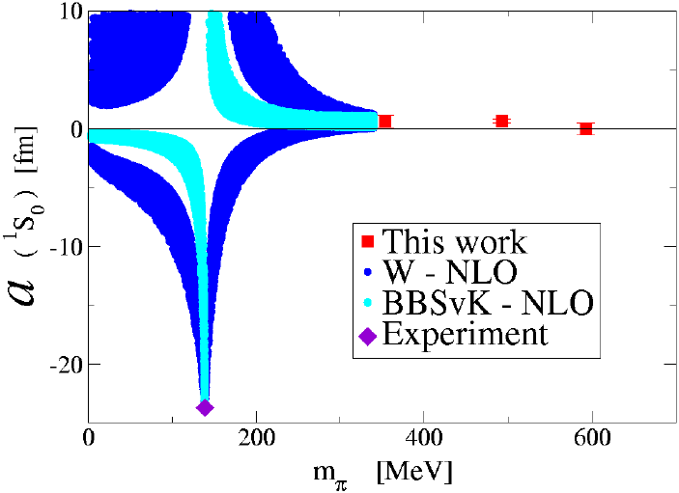

The challenge and the prospect: NN force
Ishii et al. PRL 99, 022001 (2007)
Beane et al. PRL 97, 012001 (2006)
and Phys. Rev. C 88, 024003 (2013)

Slide 39
Optimizing the nuclear force
input matters: garbage in, garbage out
The derivative-free minimizer POUNDERS was used to systematically optimize NNLO chiral potentials
The optimization of the new interaction NNLO_{opt} yields a χ²/datum ≈ 1 for laboratory NN scattering energies below 125 MeV. The new interaction yields very good agreement with binding energies and radii for A=3,4 nuclei and oxygen isotopes
Ongoing: Optimization of NN + 3NF
Used a coarse-grained representation of the short-distance interactions with 30 parameters
The optimization of a chiral interaction in NNLO yields a χ²/datum ≈ 1 for a mutually consistent set of 6713 NN scattering data
Covariance matrix yields correlation between LECCs and predictions with error bars.
Navarro Perez, Amaro, Arriola,
Phys. Rev. C 89, 024004 (2014) and
arXiv:1406.0625
A. Ekström et al., Phys. Rev. Lett. 110, 192502 (2013)
http://science.energy.gov/np/highlights/2014/np-2014-05-e/

Slide 40
Deuteron, Light Nuclei

Slide 41
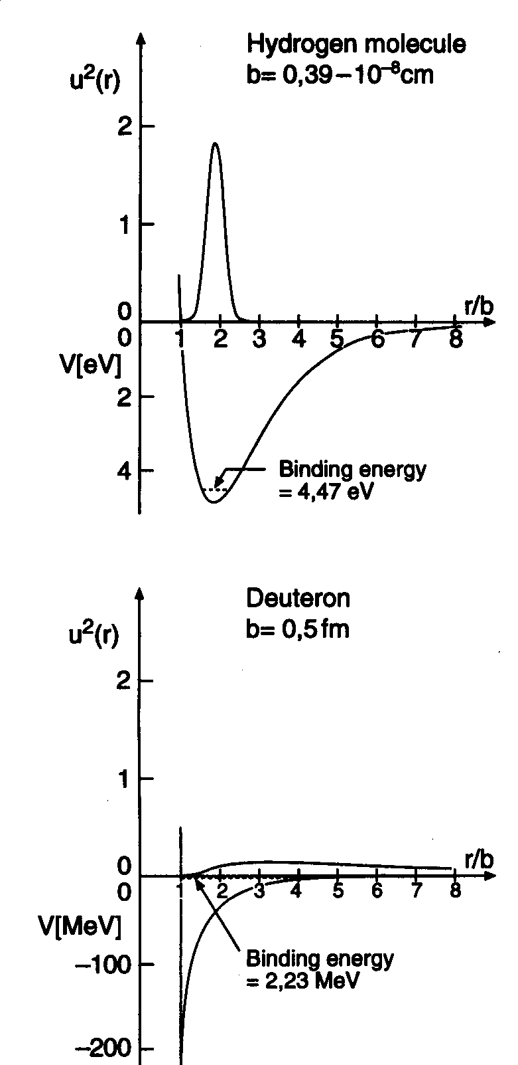
Deuteron
Binding energy | 2.225 MeV
Spin, parity | 1⁺
Isospin | 0
Magnetic moment | μ=0.857 μ_{N}
Electric quadrupole moment | Q=0.282 e fm²
produced by tensor force!

Slide 42
Nucleon-Nucleon Interaction
NN, NNN, NNNN,…, forces
GFMC calculations tell us that:
short-range
three-body

Slide 43
Few-nucleon systems
(theoretical struggle)
A=2: many years ago…
³H: 1984 (1% accuracy)
  Faddeev
  Schroedinger
³He: 1987
⁴He: 1987
⁵He: 1994 (n-α resonance)
A=6,7,..12: 1995-2014

