Slide 1
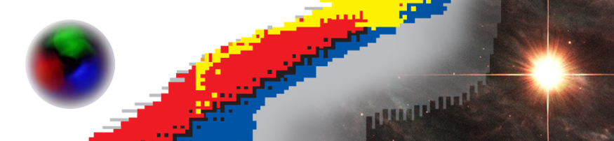

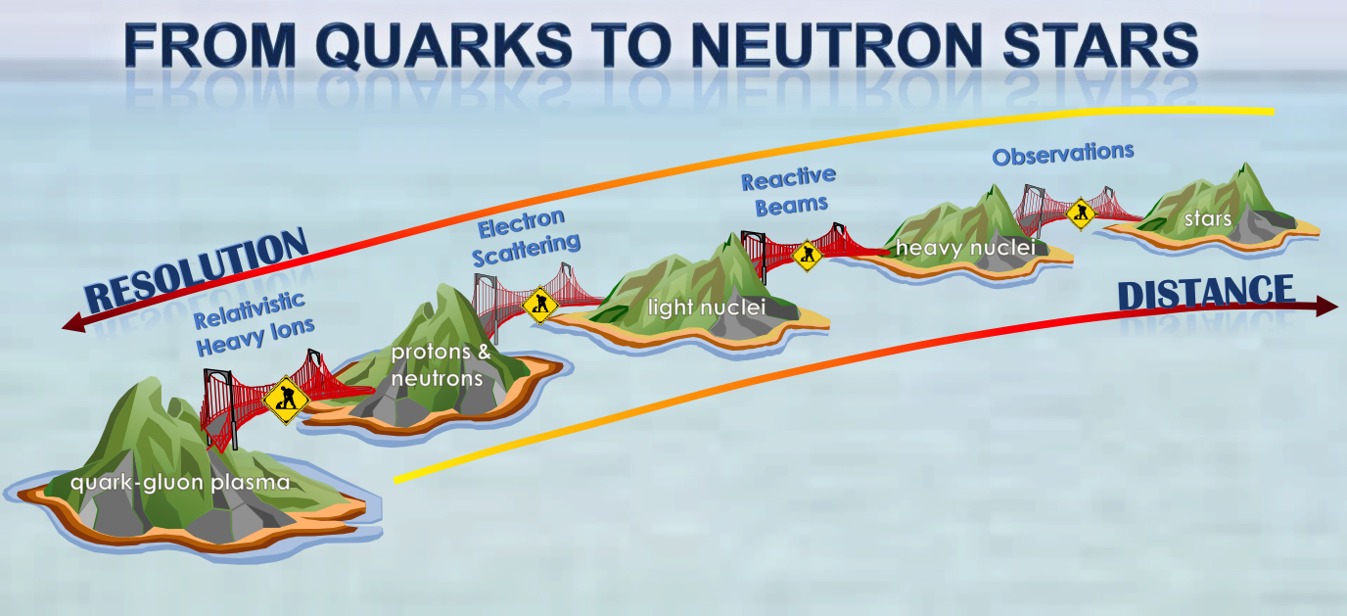
Nuclear structure I (preliminaries)
Witek Nazarewicz (UTK/ORNL)
National Nuclear Physics Summer School 2014
William & Mary, VA
Introduction: questions
Nuclear landscape
General principles
nuclear structure & reactions
nuclear astrophysics

Slide 2
2014 NNPSS, William & Mary
Nuclear Structure pre-lecture poll (W. Nazarewicz)
TALENT: Training in Advanced Low Energy Nuclear Theory
nucleartalent.org
1
2
a
b
c
d
e
f
g
h
a
b
c
d
e
f
g
h
3: basic knowledge
4: recent developments
1. Have you ever taken a nuclear structure class or course?
2. Have you ever been offered a nuclear structure class or course?
3. Are you familiar with fundamental concepts of nuclear structure, such as:
a) Liquid drop picture of the nucleus
b) Nuclear shell effects
c) Nuclear sizes and shapes
d) Nuclear force
e) Nucleonic pairing
f) Particle drip lines
g) Nuclear decays (alpha, beta, gamma, fission, ...)
h) Properties of deuteron, 208-Pb
4. Are you basically familiar with the recent developments in the following areas:
a) Stellar nucleosynthesis
b) Properties of rare isotopes
c) Computational nuclear structure theory
d) Search for superheavy nuclei
e) Nuclear aspects of neutron stars
f) Nuclei as laboratories of the new standard model
g) Emergent behavior of many-body systems
h) Open quantum systems

Slide 3
Overarching Questions

Slide 4
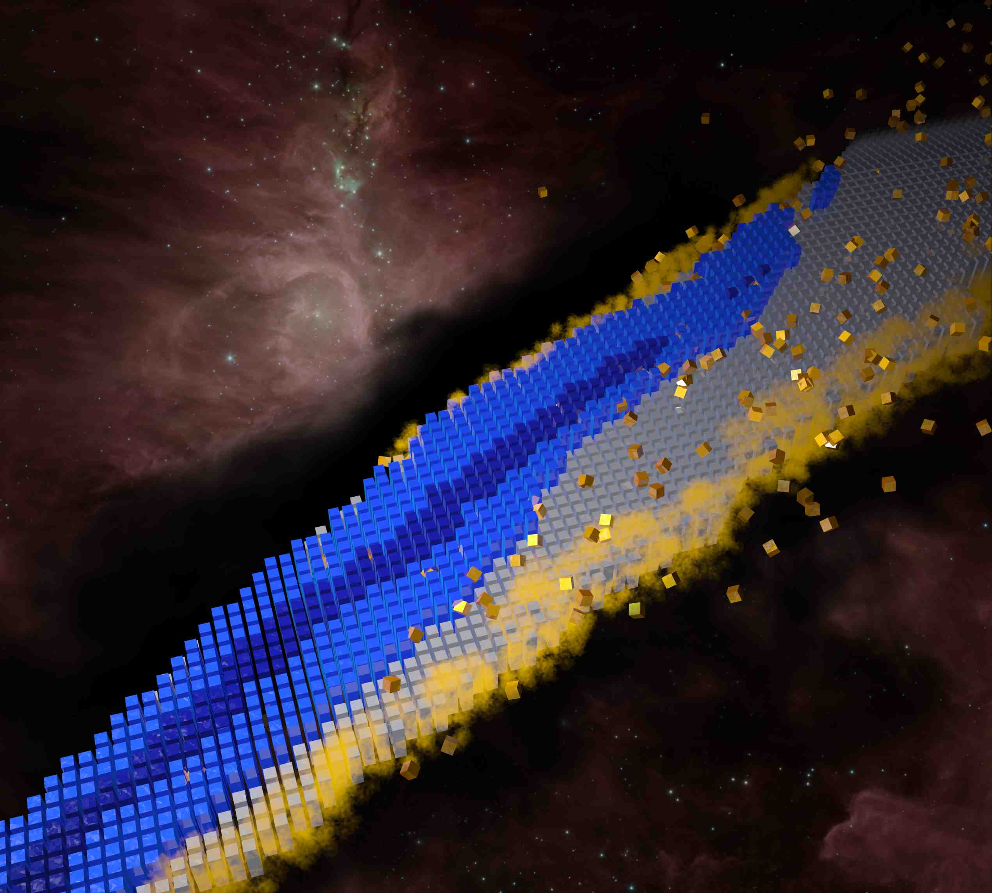
The Nuclear Landscape and the Big Questions (NAS report)
How did visible matter come into being and how does it evolve? (origin of nuclei and atoms)
How does subatomic matter organize itself and what phenomena emerge? (self-organization)
Are the fundamental interactions that are basic to the structure of matter fully understood?
How can the knowledge and technological progress provided by nuclear physics best be used to benefit society?
where the action is…
The Nuclear Landscape
QCD transition (color singlets formed): 10 ms after Big Bang (13.8 billion years ago)
D, ^{3,4}He, ⁷Be/⁷Li formed 3-50 min after Big Bang
Other nuclei born later in heavy stars and supernovae
Notes:
http://www.astro.ucla.edu/~wright/BBNS.html

Slide 5
The Nuclear Landscape

Slide 6


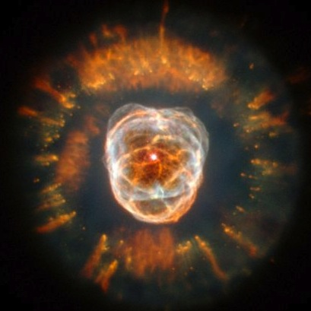
The Grand Nuclear Landscape
(finite nuclei + extended nucleonic matter)
superheavy
nuclei
Z=118, A=294
known up to Z=91
82
known nuclei
protons
proton drip line
126
terra incognita
50
82
neutron stars
28
20
neutron drip line
50
stable nuclei
8
28
2
20
probably known only up to oxygen
2
8
neutrons
Notes:
288 stable or long-lived nuclear species we can find on Earth
These are exciting times for nuclear physicists because it has become evident that it is now possible to create and accelerate beams of unstable nuclei and there are 6000 -7000 distinct nuclear species which live long enough to be candidates for acceleration
Proton drip line know up to Z=91 (protactinium)
The neutron drip line know up to oxygen
The superheavy nucleus Z=118, A=294 marks the current limit of nuclear charge and mass

Slide 7
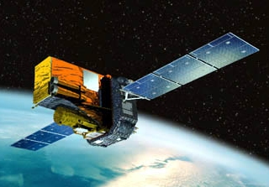
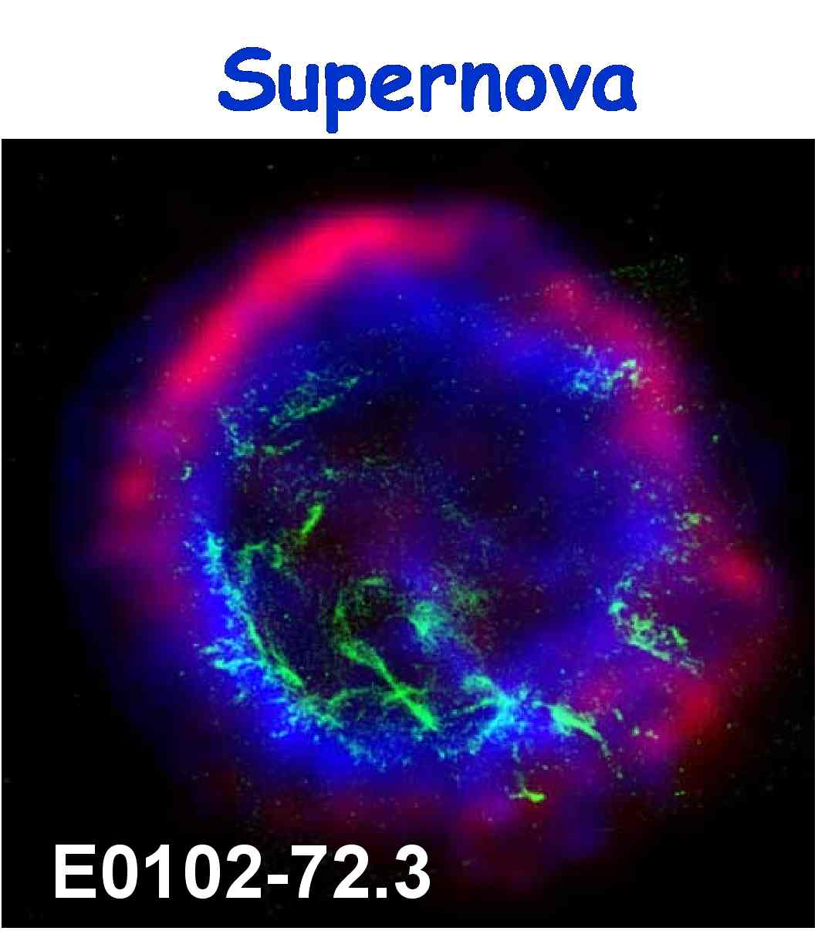
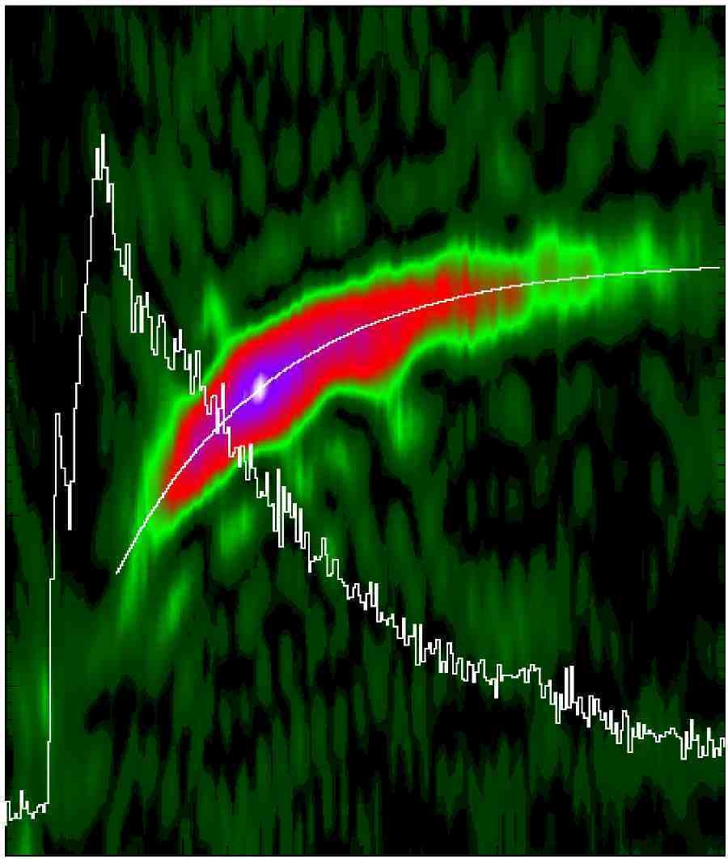
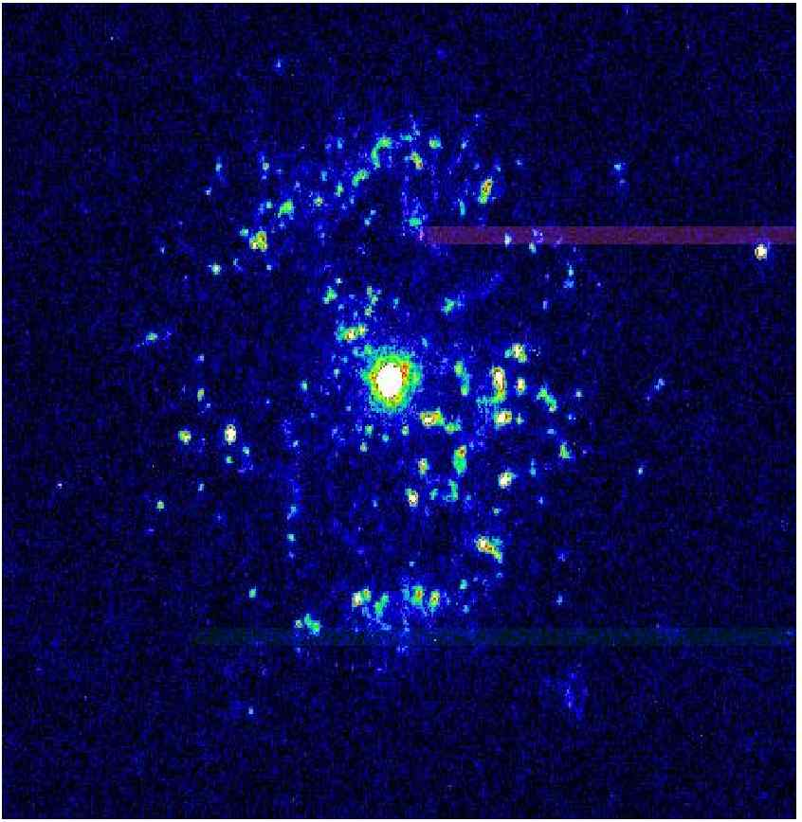
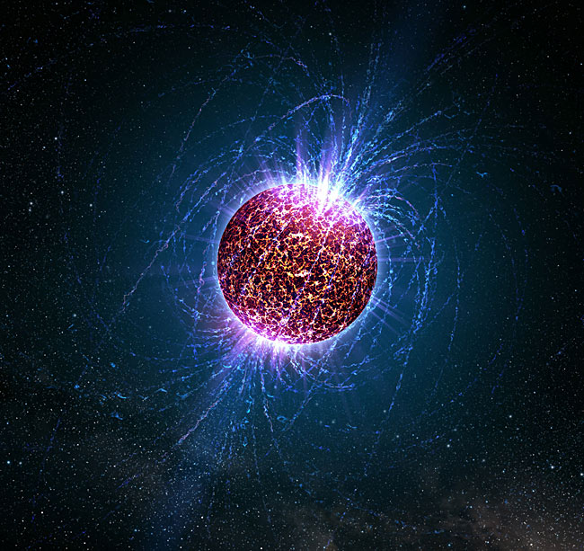
The Nuclear Landscape and the Cosmos
X-ray burst
4U1728-34
331
Frequency (Hz)
330
329
328
327
10
15
20
Time (s)
Nova
Neutron star
T Pyxidis
protons

Slide 8
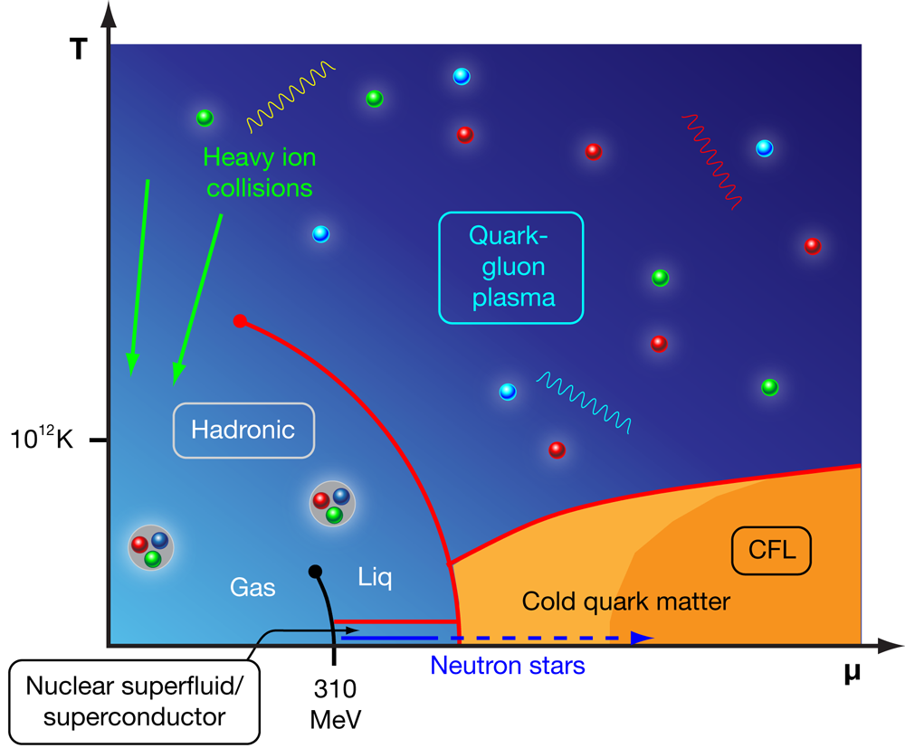
The Nuclear Landscape…
…as seen by the QCD phase diagram
…as seen by nuclear astro theory
http://physics.aps.org/articles/v3/44
Pethick and Ravenhall, Annu. Rev. Nucl. Part. Sci. 45, 429 (1995)

Slide 9
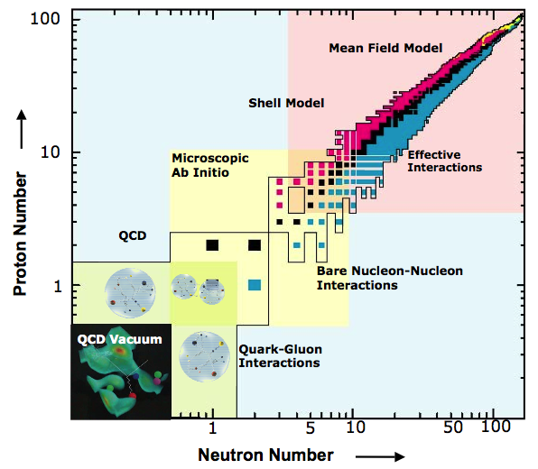
The Nuclear Landscape
…as seen by Jefferson Lab
A: 0, …, 1, 1, 2, 4, ²⁰⁸Pb, ∞

Slide 10


Testing the fundamental symmetries of nature
Parity violation
studies in francium
126
82
Weak interaction
studies in N=Z nuclei
EDM search
in radium
ββ0ν searches
50
protons
82
Specific nuclei offer new opportunities for precision tests of:
  CP and P violation
  Unitarity of the CKM matrix
  …
28
20
50
8
28
2
20
neutrons
8
How will we turn experimental signals into precise information on physics beyond the standard model?
2
neutron EDM
Notes:
Laser trapping and cooling of radium atoms (both Ra-226 and Ra-225) realized for the first time ever at ANL
Double-beta decay: neutrino masses, Majorana character: 82Se,100Mo,116Cd,130Te, 150Nd

Slide 11
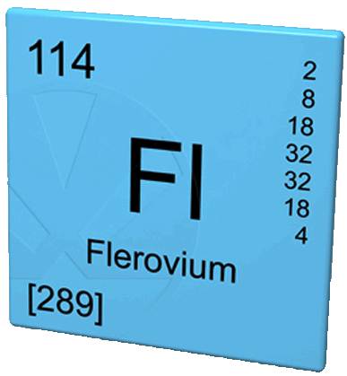
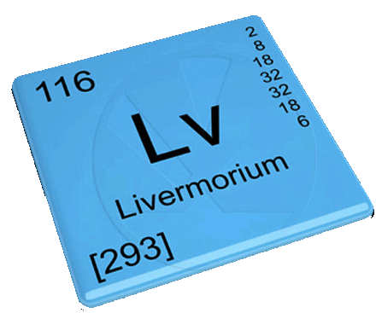
The Nuclear Landscape…
…as seen by chemists…
Periodic Table of Elements 2014
Cn
113
Fl
115
Lv
117
118
112
114
116

Slide 12
General Principles

Slide 13
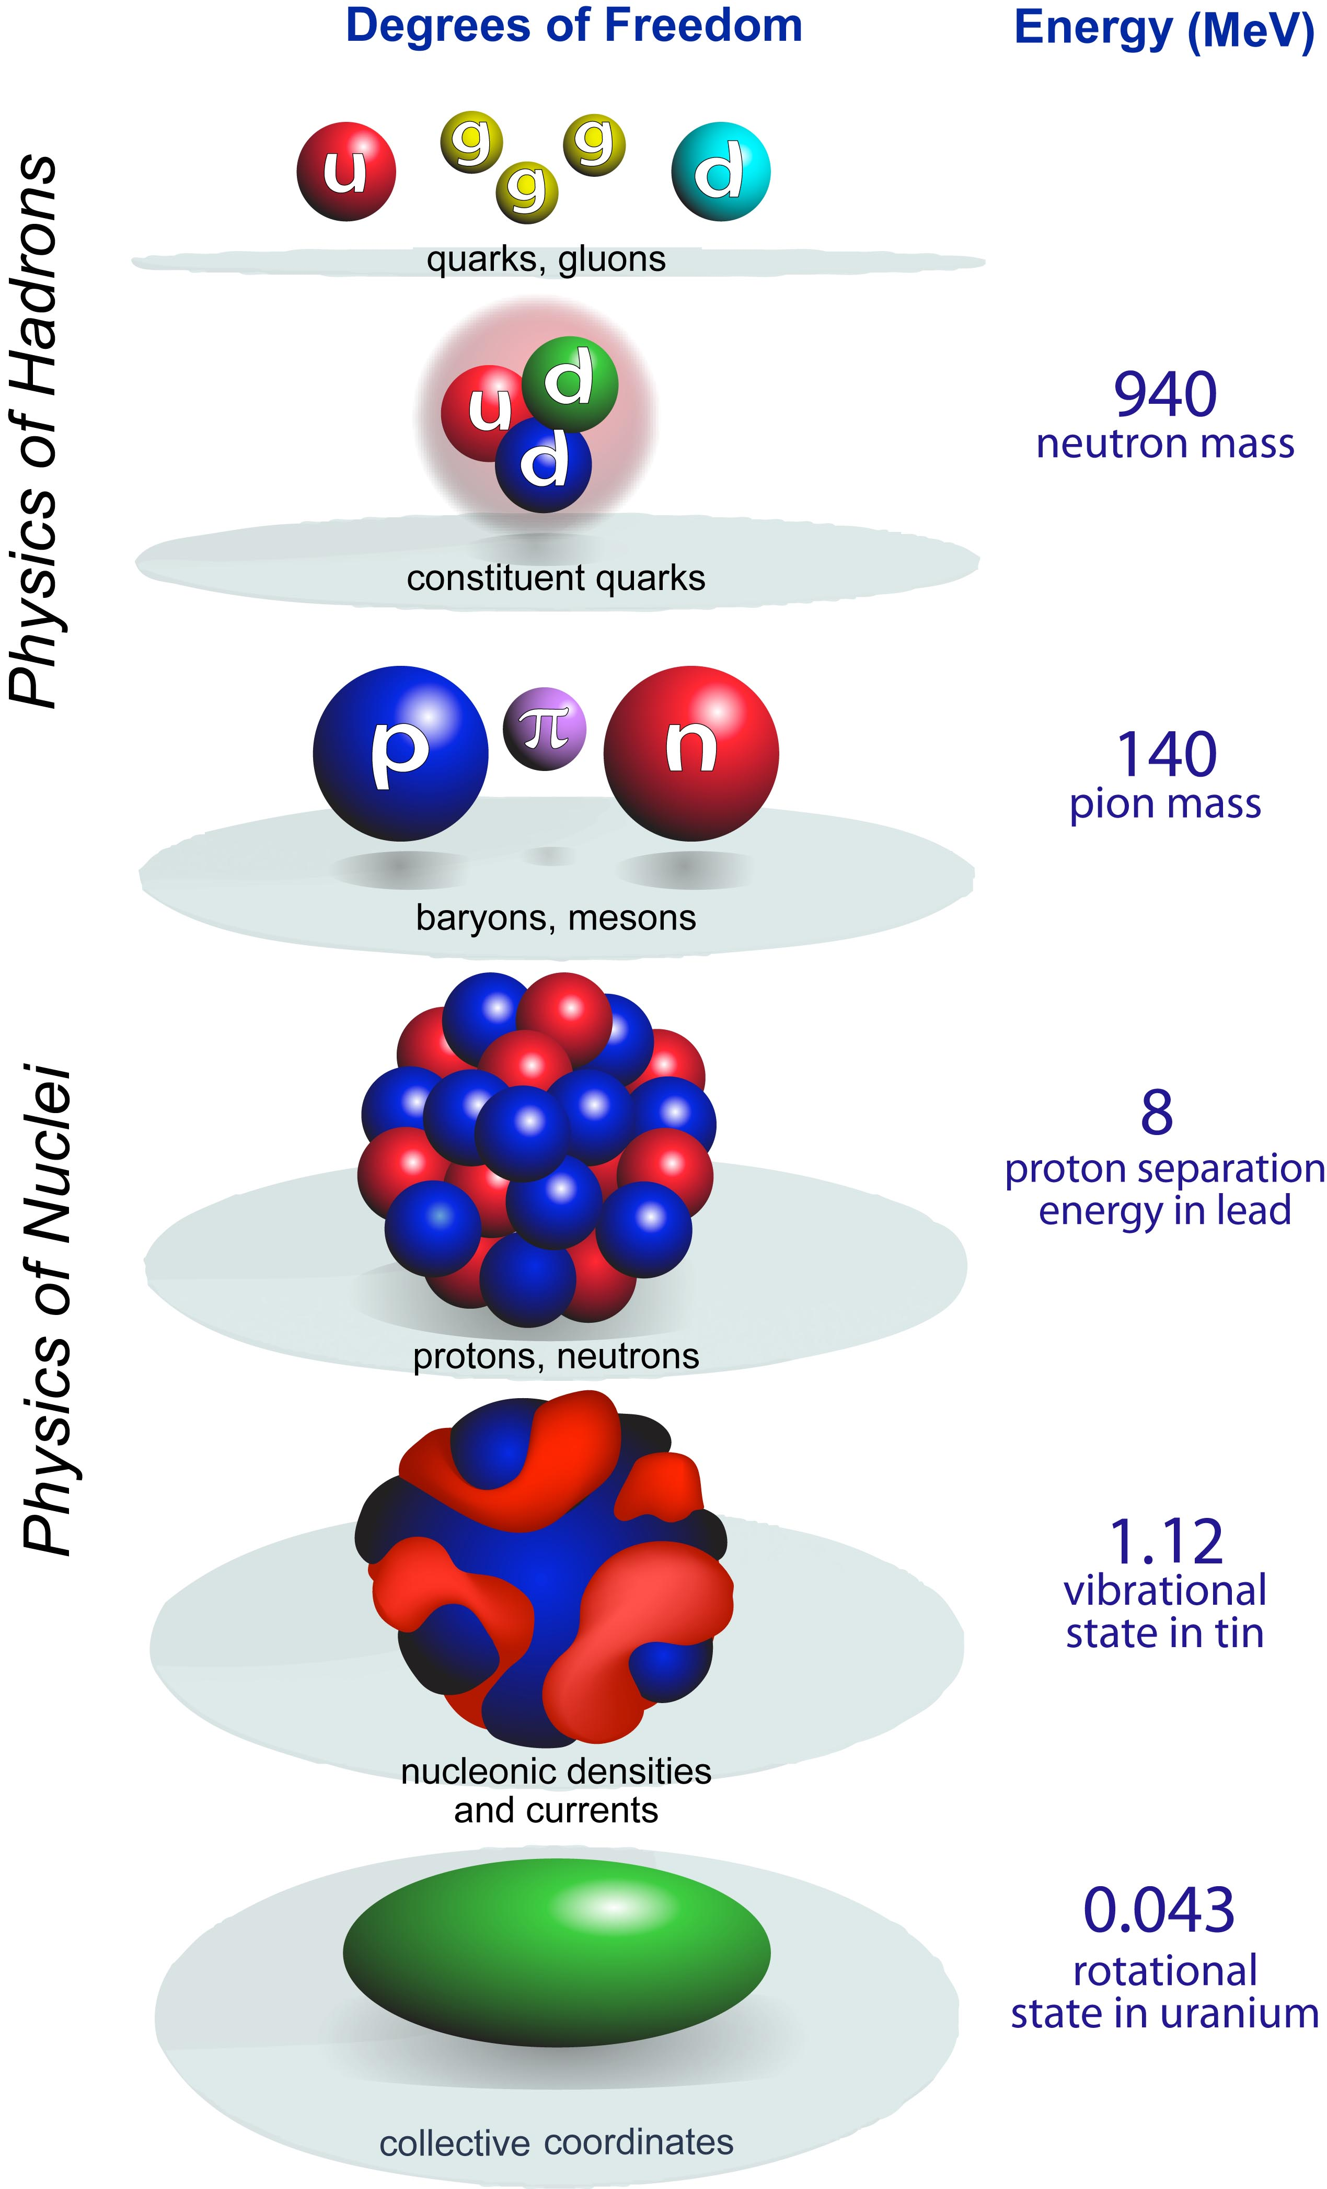

How are nuclei made?
Origin of elements, isotopes
LQCD
scale
separation
Hot and dense quark-gluon matter
Hadron structure
quark
models
Resolution
Hadron-Nuclear interface
ab initio
Nuclear structure
Nuclear reactions
New standard model
CI
Effective Field Theory
DFT
Third Law of Progress in Theoretical Physics by Weinberg:
“You may use any degrees of freedom you like to describe a physical system, but if you use the wrong ones, you’ll be sorry!”
Applications of nuclear science
collective
models
To explain, predict, use…
Notes:
Degrees of freedom of the strongly-interacting many-body problem

Slide 14
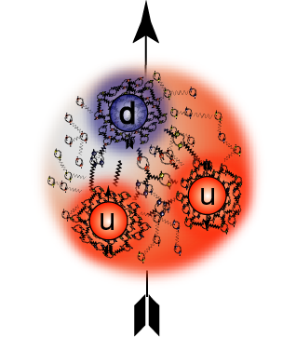
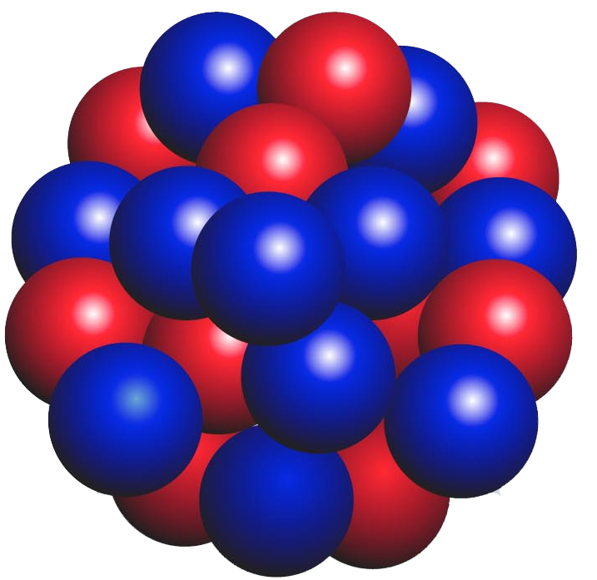
The Hadronic Many-Body problem
s=1/2
J=2
proton
nucleus
hadron spectroscopy
The origin of confinement
The origin of mass, spin
Quantum numbers and symmetries
nuclear spectroscopy
The origin of nuclear force
The origin of binding, spin
Quantum numbers and symmetries

Slide 15
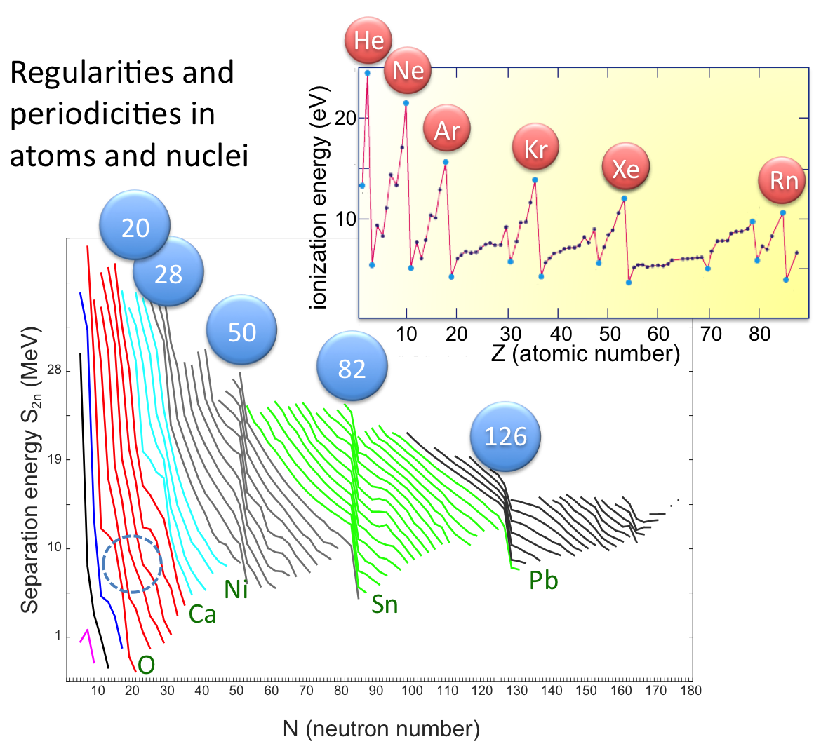
Notes:
Goepper-Meyer, Hans Jensen

Slide 16
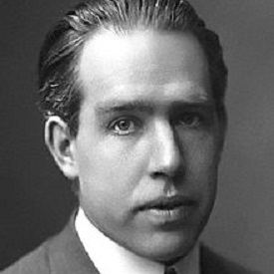
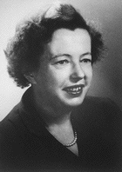
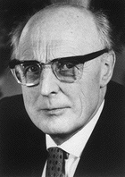

1949
1912
electronic shells of the atom
nucleonic
shells of
the nucleus
Nobel Prize 1922
54
Xe
Nobel Prize 1963
126
3p_{1/2}
Bohr’s picture still serves as an elucidation of the physical and chemical properties of the elements.
5p
2f_{5/2}
4d
5s
1i_{13/2}
36
Kr
3p_{3/2}
4p
1h_{9/2}
3d
2f_{7/2}
noble gases
(closed shells)
4s
magic nuclei
(closed shells)
82
18
Ar
2d_{3/2}
3p
1h_{11/2}
3s
3s_{1/2}
1g_{7/2}
10
Ne
2d_{5/2}
2p
50
We know now that this picture is very incomplete…
2s
1g_{9/2}
Notes:
Goeppert Mayer, J. Hans D. Jensen 1963

Slide 17
Wikipedia:
An open quantum system is a quantum system which is found to be in interaction with an external quantum system, the environment. The open quantum system can be viewed as a distinguished part of a larger closed quantum system, the other part being the environment.
INTERDISCIPLINARY
Small quantum systems, whose properties are profoundly affected by environment, i.e., continuum of scattering and decay channels, are intensely studied in various fields of physics: nuclear physics, atomic and molecular physics, nanoscience, quantum optics, etc.
environment
Example: EM radiation
OQS
http://www.phy.ornl.gov/theory/MBOQS/Manifesto_09.html

Slide 18
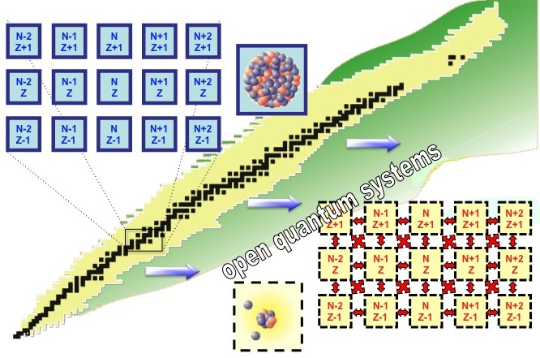
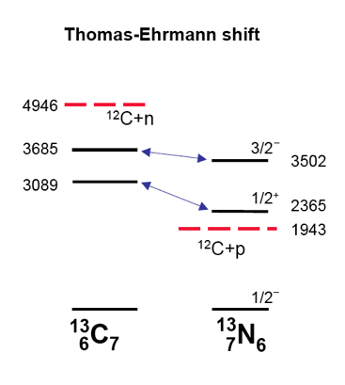
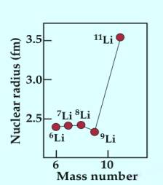
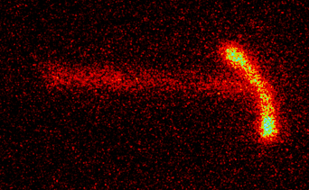
Nucleus as an open quantum system
⁴⁵Fe

Slide 19
Nuclear theory: guiding principles
NN interaction is short-ranged, spin- and isospin-dependent
Nucleonic mean fields and single-particle motion provide zeroth-order picture
Shell structure
Mean fields can break symmetry of nuclear Hamiltonian
Appearance of emergent behavior and collective modes
Symmetry-driven many-body coupling schemes
Correlations and quasiparticles
Quantum corrections
Openness
shell
gap
shell
gap
shell
(Band) structures labeled by quantum numbers of the internally broken symmetries
Time scale of single-particle and collective motion not very different

Slide 20
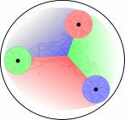

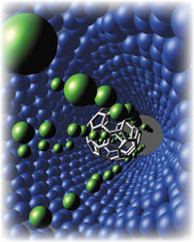
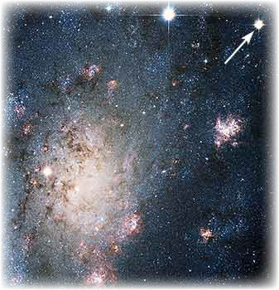
Profound intersections
subfemto…
nano…
femto…
Giga…
Complex
Systems
Physics
of Nuclei
Cosmos
Quantum many-body physics
Astrophysics
Astronomy
How do collective phenomena emerge from simple constituents?
How can complex systems display astonishing simplicities?
What are unique properties of open systems?
Fundamental
interactions
How do nuclei shape the physical universe?
What is the origin of the elements?
What is the New Standard Model?
Notes:
20

Slide 21
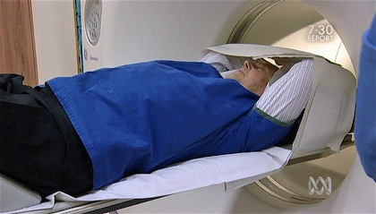

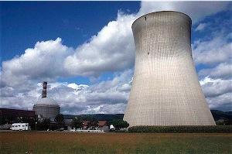
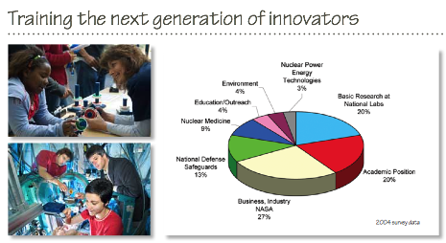
Societal Benefits
Energy, transmutation of waste…
Medical and biological research
Materials science
Environmental science
Stockpile stewardship
Security
Computing
http://www.sc.doe.gov/np/brochure/index.shtml
Notes:
Energy, transmutation of waste…
Can we use fast neutron reactors and accelerators for the mitigation of long-lived radioactive waste?
Can we design an economically competitive, energy efficient, reduced-waste nuclear reactor?
Medical and biological research
Materials science
Stockpile stewardship and inertial fusion

Slide 22
What are the next medically viable radioisotopes required for enhanced and targeted treatment and functional diagnosis?
Example: Targeted Alpha Therapy in vivo
The radionuclide ¹⁴⁹Tb decays to alpha particles 17 percent of the time and has a half-life of 4.1 hours, which is conveniently longer than some other alpha-emitting radionuclides. Low-energy alpha particles, such as in ¹⁴⁹Tb decays, have been shown to be very efficient in killing cells, and their short range means that minimal damage is caused in the neighborhood of the target cells.
α-knife!
First in vivo experiment to demonstrate the efficiency of alpha targeted therapy using ¹⁴⁹Tb produced at ISOLDE, CERN
G.-J. Beyer et al. Eur. J. Nucl. Med. and Molecular Imaging 33, 547 (2004)
Notes:
Only a few nuclear hits are needed to kill cells

Slide 23
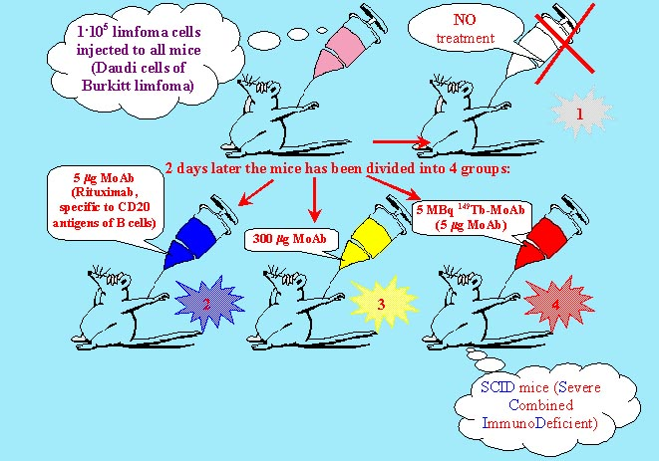
5*10⁶
Survival of mice…
100
5 MBq
149
Tb, 5 µg MoAb
90
80
Monoclonal Antibody
70
no MoAb
2 days later the mice have been devided into 4 groups:
60
% of survived mice
300 µg MoAb, cold
50
40
5 µg MoAb, cold
30
20
10
0
0
20
40
60
80
100
120
Survival time, days
Notes:
A scheme of endoradiotherapy, in which a monoclonal antibody (MoAb) molecule labeled with radionuclide 149Tb, being an alpha-emitter, is bound to a protein strand occurring only in cancer cells. In average, three hits of the cell by the alpha-particles are sufficient to kill it. The figure gives the survival curve of the SCID mice infected

